Slide 2
Mondopad Ultra 3.0
Technical Training
Steve Reynolds
Sept 4, 2018

Slide 3
What's New
Home Screen
New Ultra Background
Bottom Toolbar Customizable for User Usage
Documents
Added support for Mapped drives now for both Domain/Non-Domain accts
Browser
Updated Chromium – Supports Google Apps and much more
Office365
Office 365 Login providing Online User Account App Access
QR Code for NEW Mondopad Phone login app for Android & iPhone quick login access

Slide 4
What's New
Applications
New Applications module for 3rd party apps. Displays all applications that are installed in Windows
Customizable Drag & Drop Apps into Bottom Toolbar in any order
Other
Video Meeting UI Cleanup
Added Spanish Support for Mondopad

Slide 5
Overview
Home Screen
Documents
Browser
Office365 Module
Whiteboard
Cast
Video Meeting (ConX)
Applications
Settings
Reset Meeting
Schedule

Slide 6
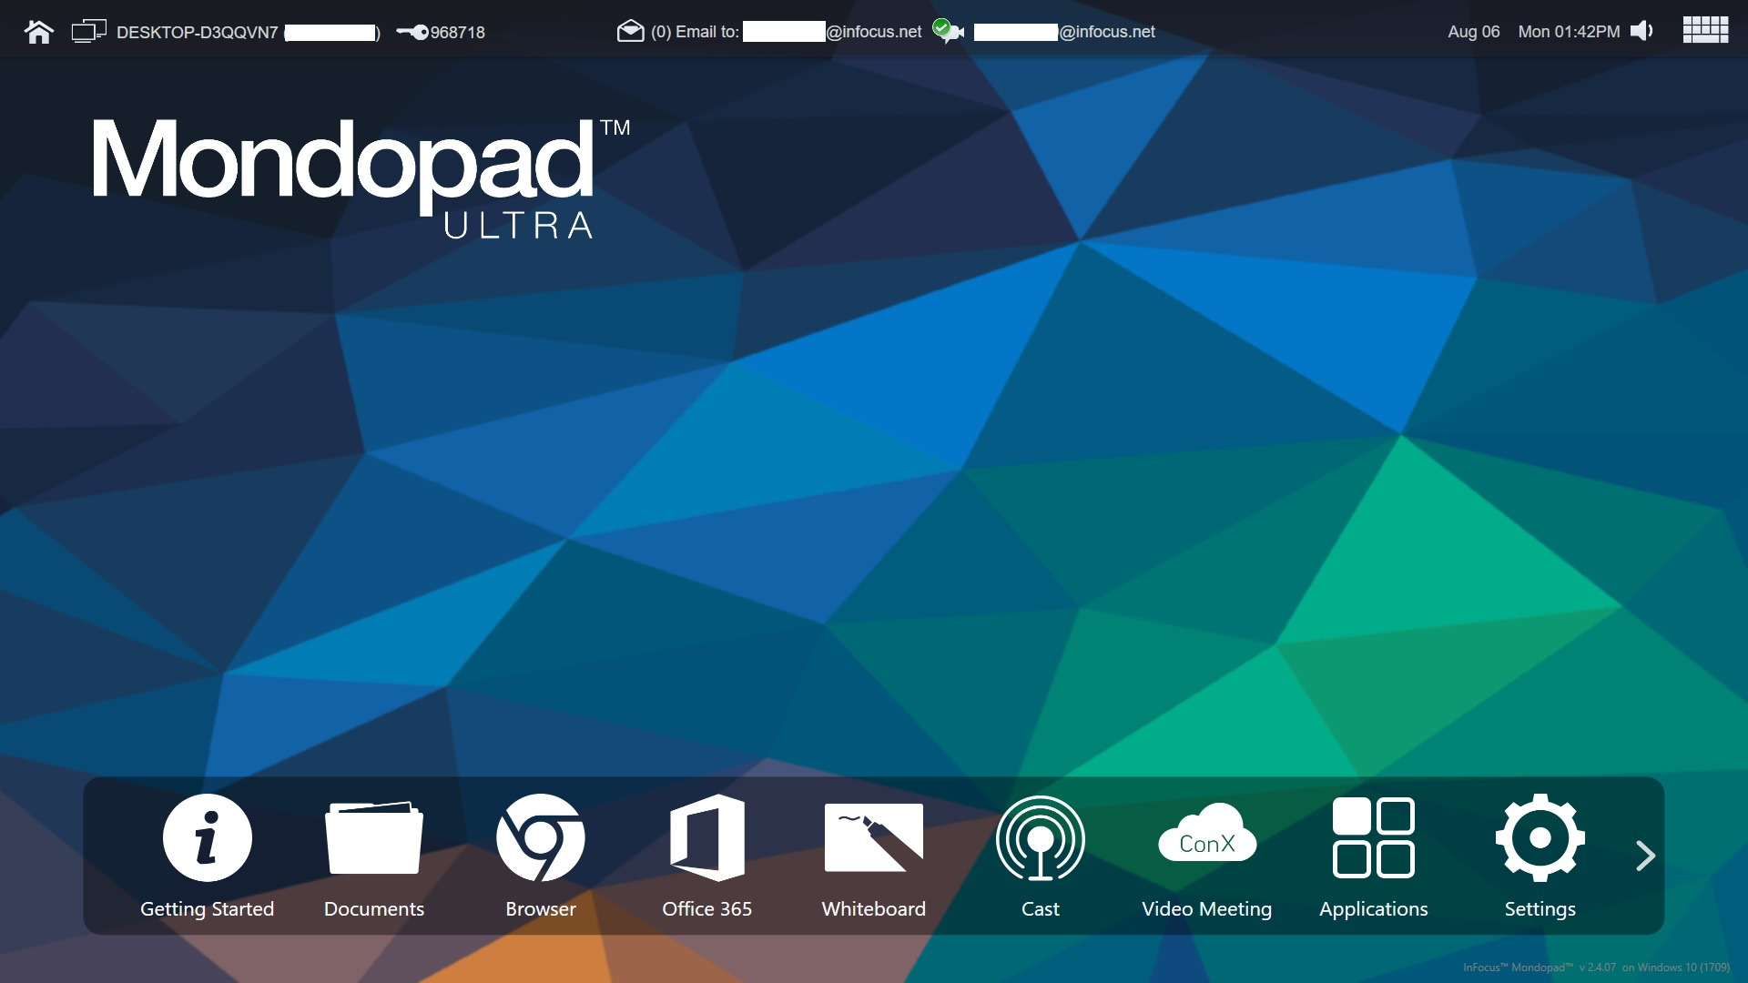

Home Screen
Home Screen

Slide 7
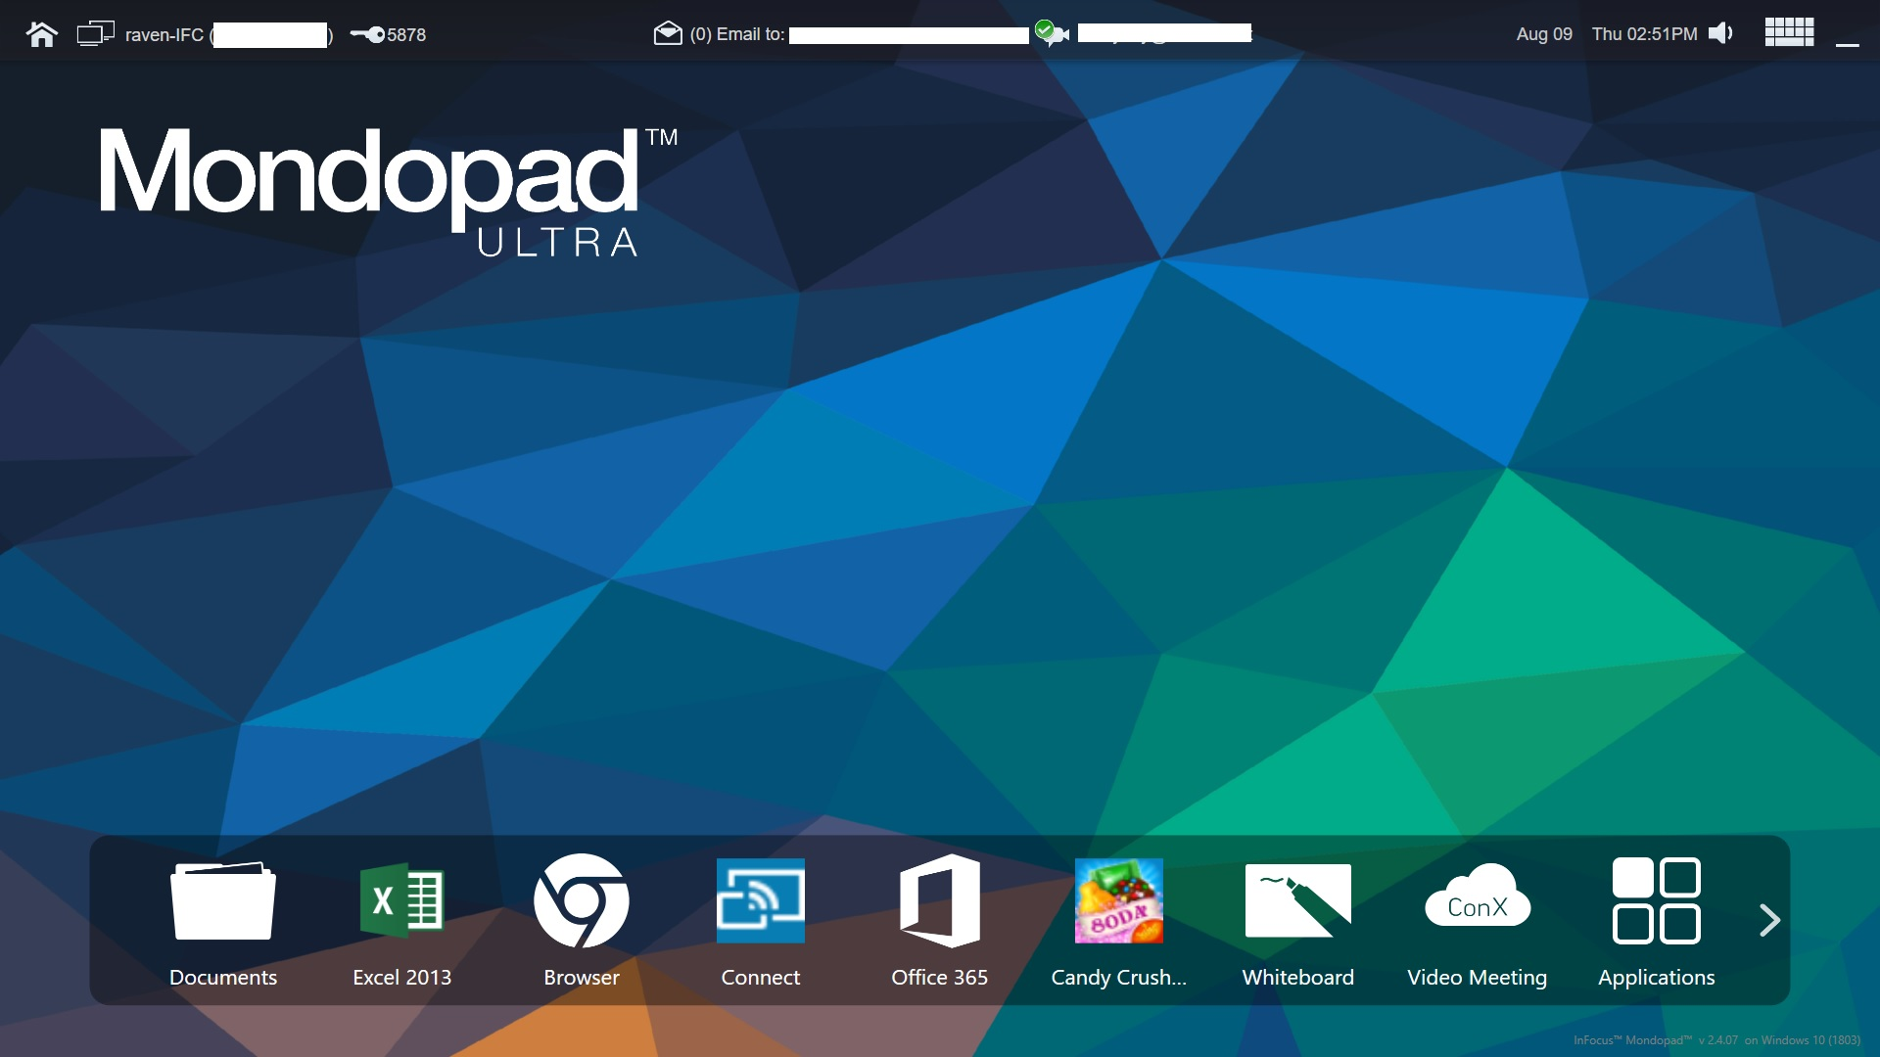
Home Screen
Home Screen
Added ability to customize the bottom bar by reordering items that best suits the customer use environment

Slide 8
Home Screen
Home Screen – Hot Keys
MP->MP Invite Change Admin Pin
Home Screen Browser Admin
Documents Video Meeting

Slide 9
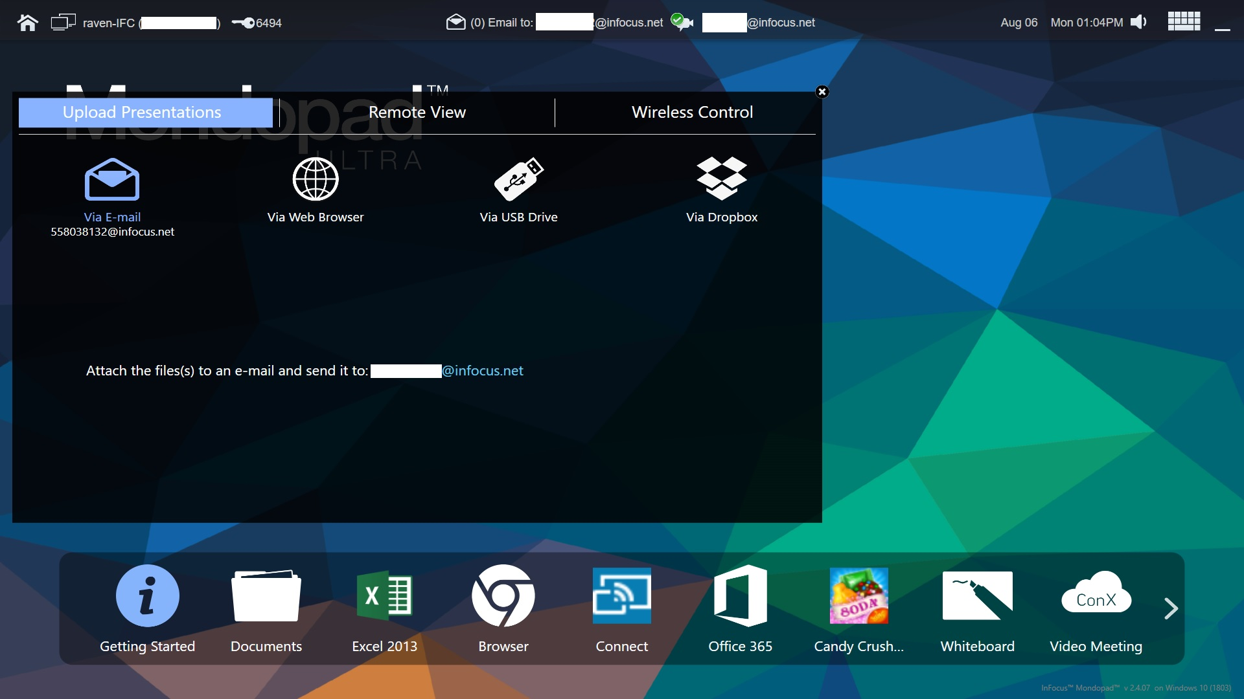
Getting Started Screen
Getting Started
Upload Presentation
Email attachment to address on upper toolbar
Connect Device Browser to Mondopad IP address
Connect USB Drive
Connect to Dropbox

Slide 10
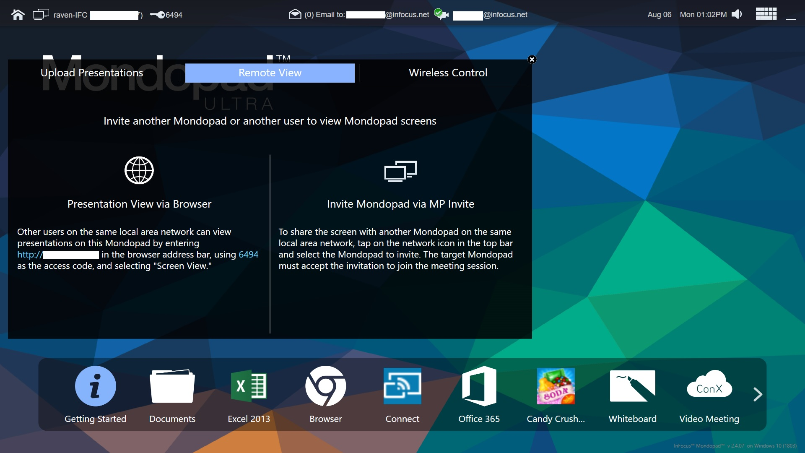
Getting Started Screen
Getting Started
Remote View
Connect Device Browser to Mondopad IP address
Mondopad to Mondopad Invite session

Slide 11
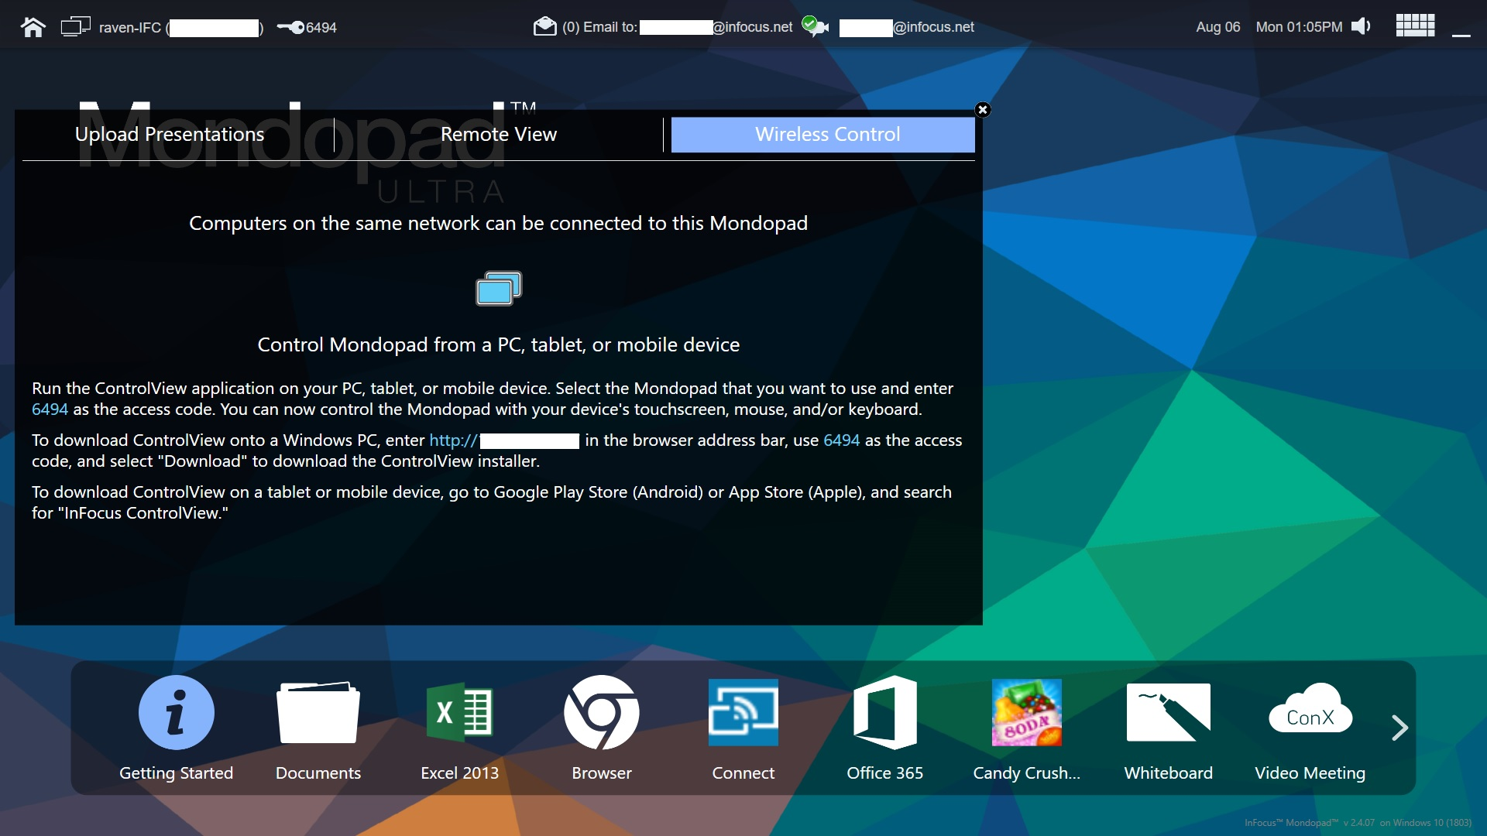
Getting Started Screen
Getting Started
Wireless Control
ControlView 2 Application from PC device (can be downloaded from connecting Browser to Mondopad IP address)
Connect Device Browser to Mondopad IP address
Connect Android Tablet to Play Store and Download ControlView

Slide 12
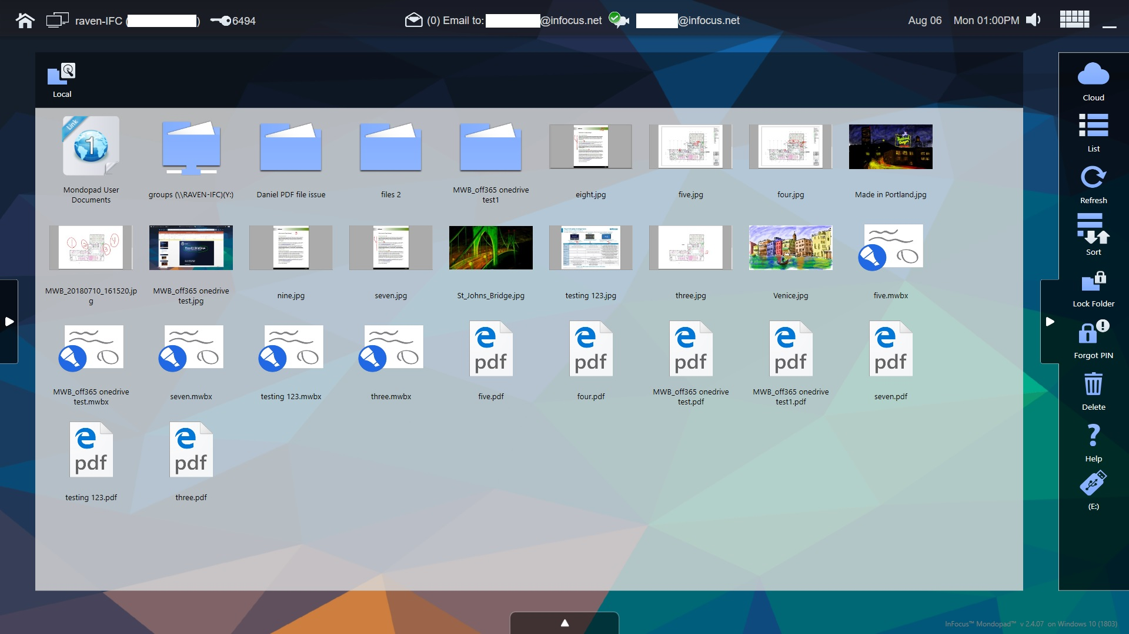
Document Screen
Documents
Documents
DropBox Cloud
Network Folder(s)
Mondopad Primary File Screen
USB Drives shown
These are all available sources for storing/ accessing your files.
Note: New with Mondopad Ultra Mapped Drives support on non-domain login as well a domain login accounts

Slide 13
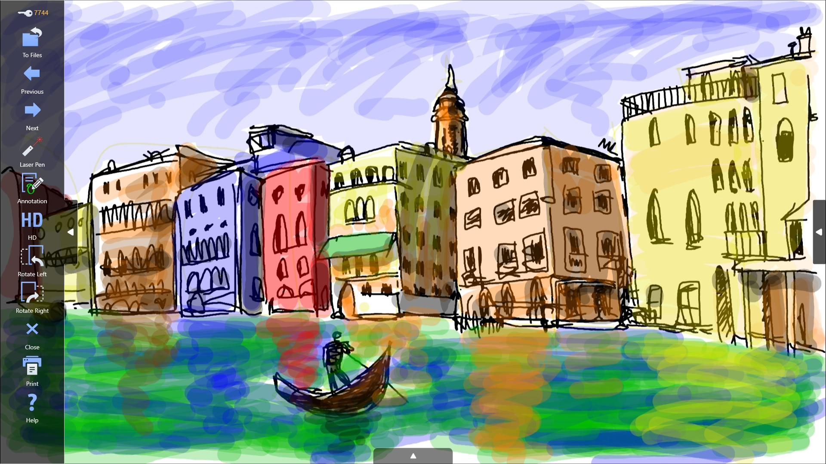
Document Screen
Documents – Open File Sidebar
Documents Open File
Back to Documents Folder
Scroll Back/Previous
Scroll Forward/Next
Laser Pointer
Annotation (edit over document)
Show Image in HD
Rotate Left
Rotate Right
Close File
Print (requires Admin setup)
Help

Slide 14
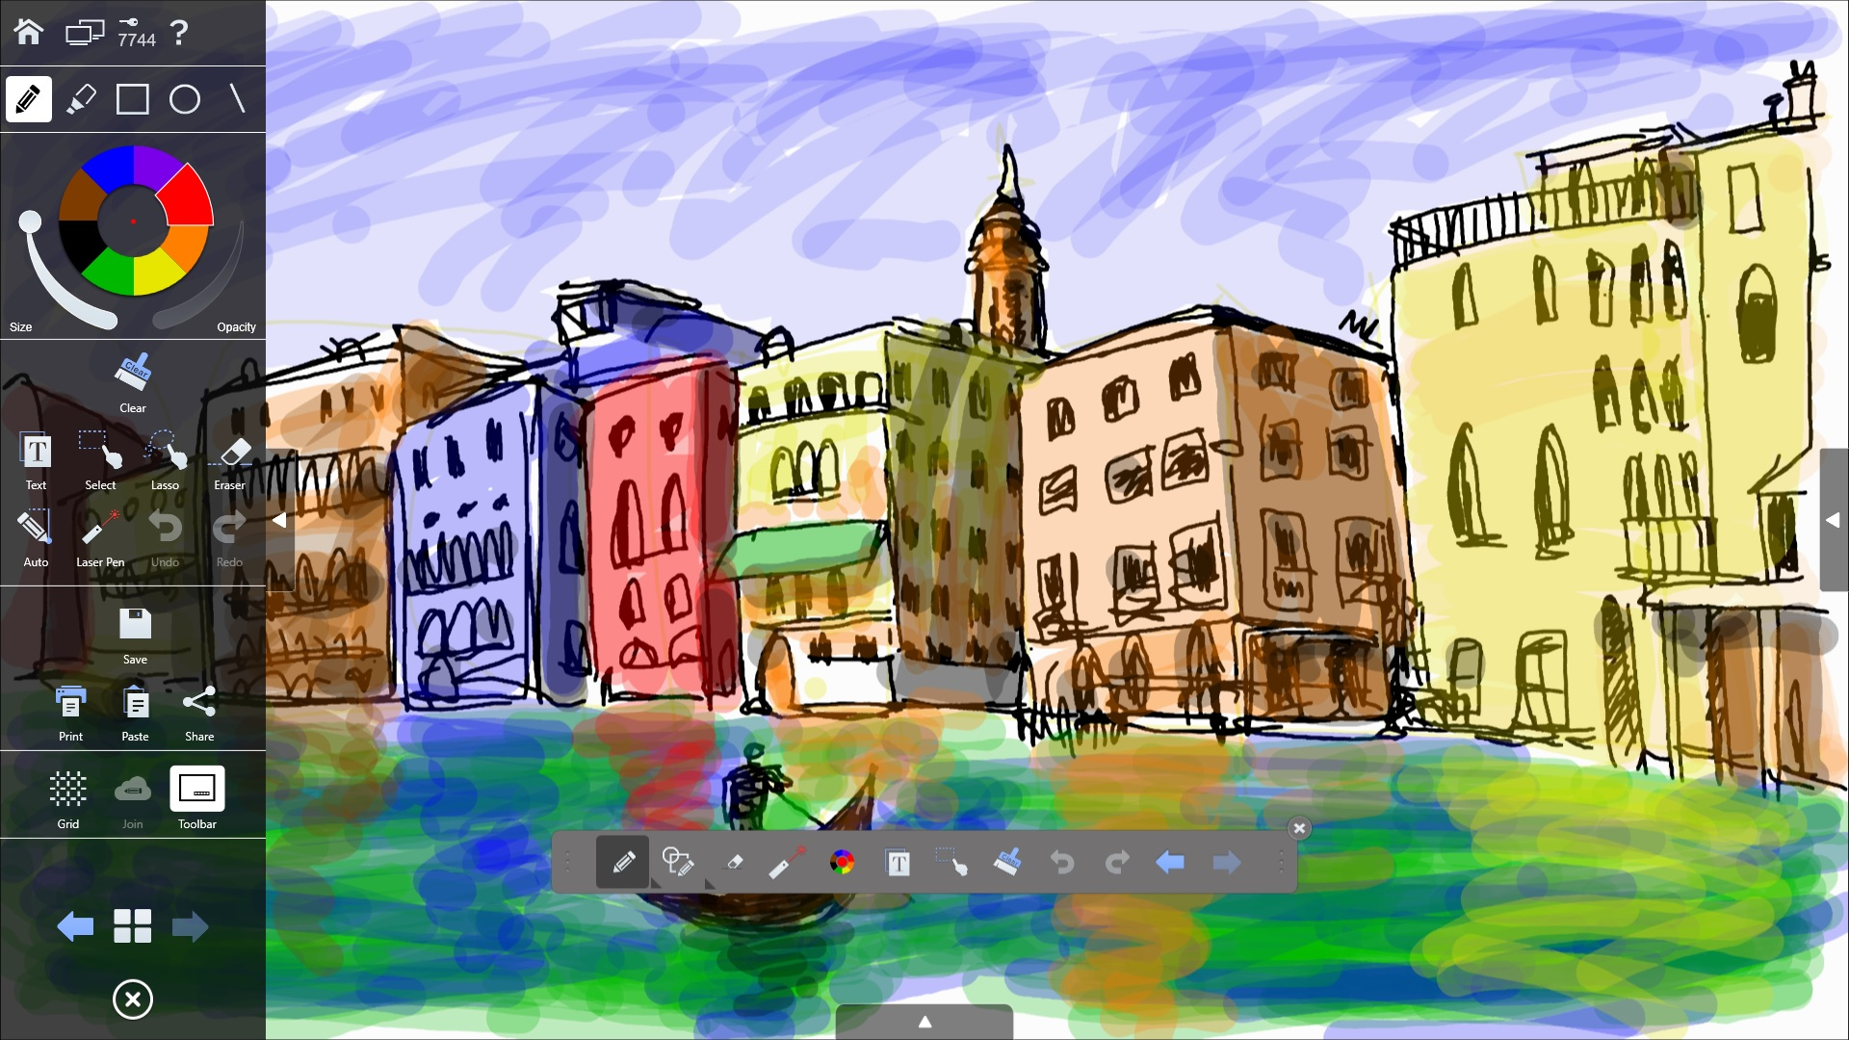
Document Screen
Documents – Open File Sidebar
Documents Annotation
Home, MP-MP Invite, Admin Key, Help
Pen/Highlighter Color Select
Clear Annotation, Text, Select/Lasso, Erase, Auto Draw, Laser Pointer, Redo/Undo
Save, Print, Paste and Share to email client(s)
Grid and Enable/Disable Onscreen toolbar
Select Page in Canvas
Close

Slide 15
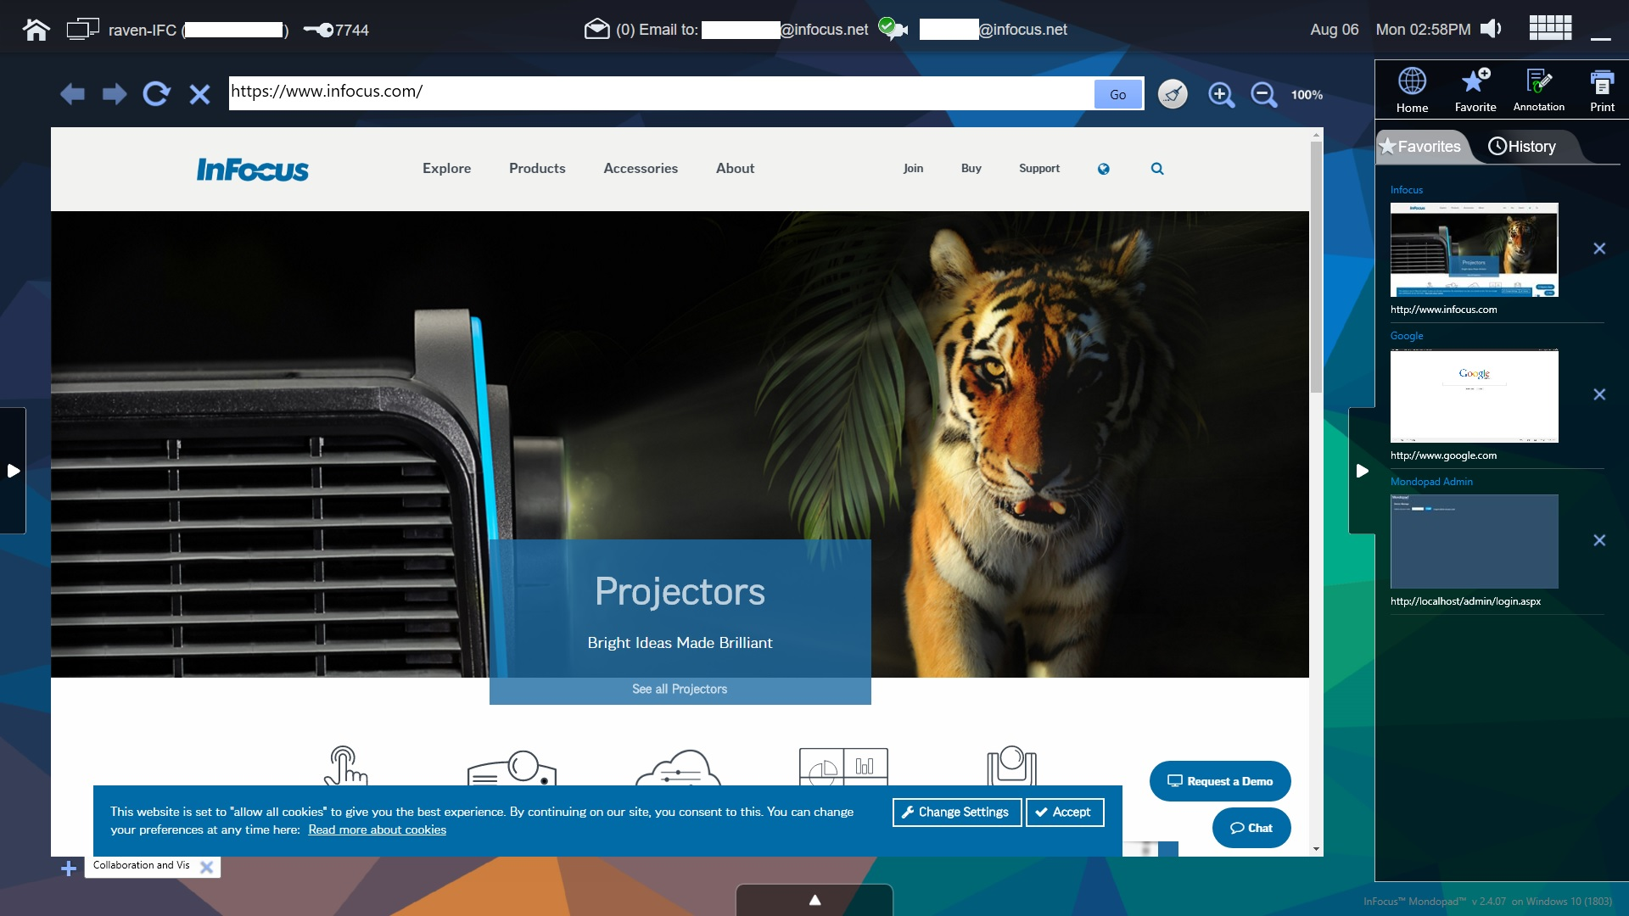
Browser Screen
Browser
Browser Sidebar
Home (goes to Homepage set in Browser Admin)
Favorites (Create/Save Favorites Web links)
Annotation (allows annotation over webpages/websites)
Print (Requires Admin setup of available printers)
Favorites & History tab plus option to delete saved site/page
Note:
Mondopad Sidebar can be opened from either the left or right side of the screen

Slide 16
Browser Screen
New features in Browser Admin
Device Tab – “Video Meeting Settings” Section enable/disable Video Meeting module tabs “Settings”, “Accounts” and/or “Status” (default these three are disabled)
Home Screen – addition of Office 365 Module
Removal of “Extras” Tab – all application functions transferred to the NEW “Applications” Module Sidebar “Config”
“Extras” option setup for enable/disable Log off User, Reboot & Shutdown moved to “Device” tab.

Slide 17
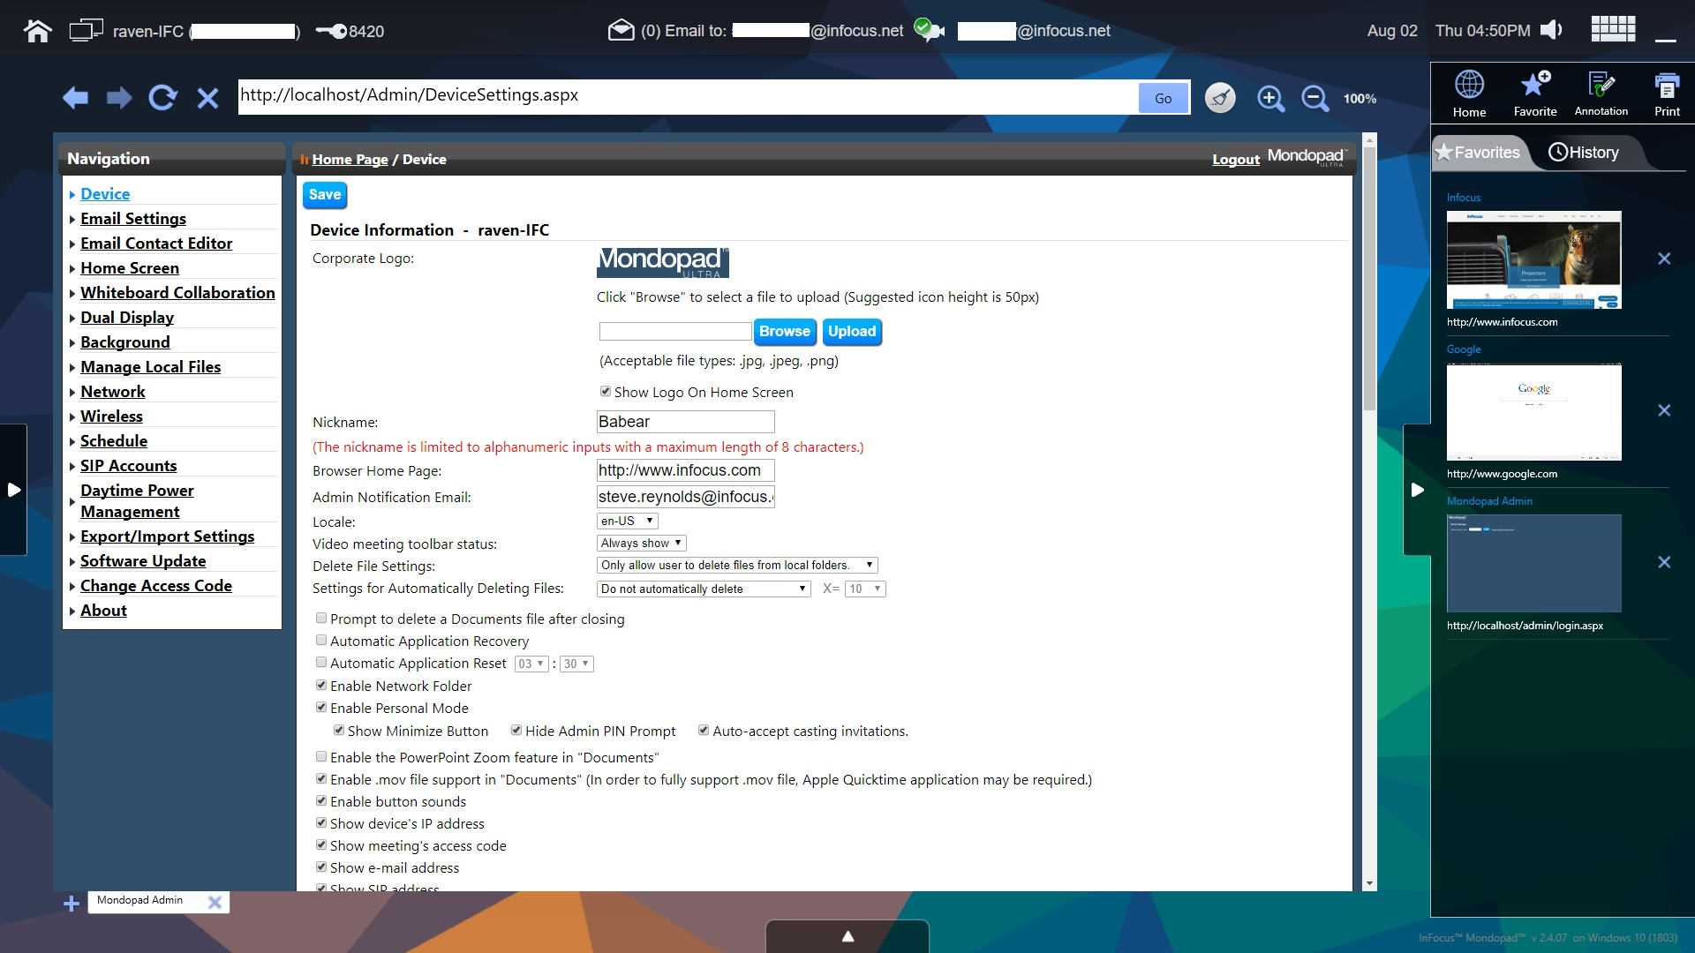
Browser Screen
Browser Admin section 1
Admin Device
Onscreen Logo
Network Nickname
Browser Home Page
Admin Email
Language
Video Meeting Status Bar – show options
Settings for automatically deleting files
Prompt to delete after file close
Automatic Application Recovery
Automatic Application Reset
Enable network folders
Admin Device
Enable Personal Mode or Disable for Kiosk
Enable PowerPoint Zoom in Documents
Enable .mov file support in Documents
Enable button sounds
Show Device IP address
Show meeting access code
Show email address

Slide 18
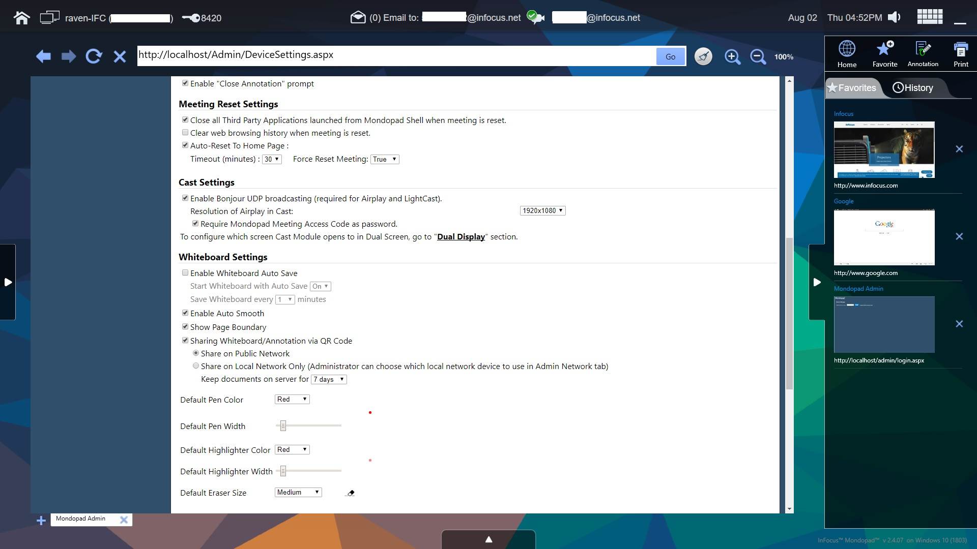
Browser Screen
Browser Admin section 2
Admin Device
Enable Close Annotation prompt
Meeting Reset Settings
Close 3rd party applications
Clear Web Browsing
Auto-reset to Home page options
Cast Settings
Enable Bonjour for Airplay
Require MP Access code as password
Admin Device
Whiteboard Settings
Enable Whiteboard AutoSave (options)
Enable Auto Smooth
Show Page Boundaries
Share Whiteboard annotation over QR Code (options)
Default Pen Color
Default Pen Width
Default Highlighter Color
Default Highlighter Width
Default Eraser Size

Slide 19
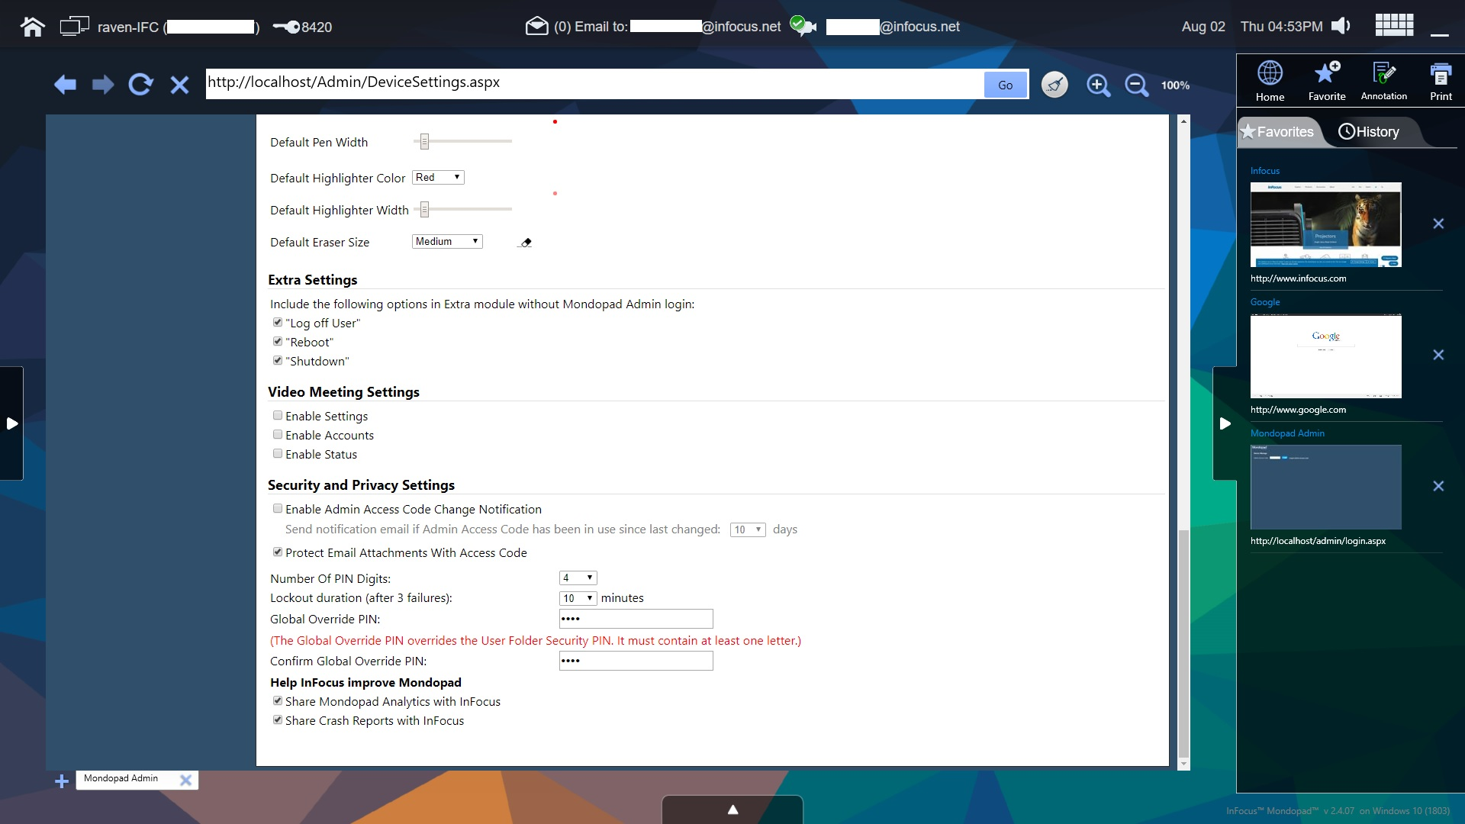
Browser Screen
Browser Admin section 3
Admin Device
Extra Settings
Log off user (show)
Reboot (show)
Shutdown (show)
Video Meeting Settings
Enable Settings (show)
Enable Accounts (show)
Enable Status (show)
Admin Device
Security and Privacy Settings
Enable Access code change notification
Protect email attachments with access code
Access code pins 4 or 6
Lockout duration
Admin Global override pin
Help InFocus Improve Mondopad
Share Mondopad Analytics
Share Crash Reports

Slide 20
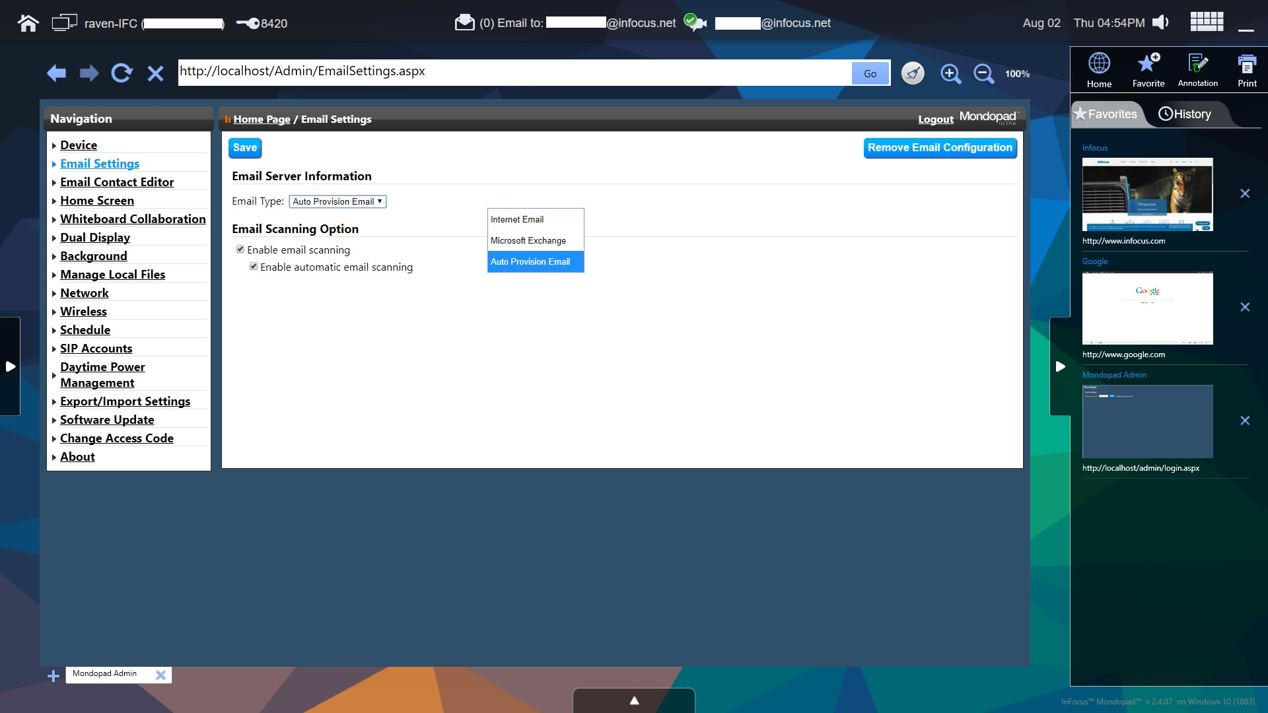
Browser Screen
Browser Admin Email Settings
Admin Email Settings
Email Server Information
Email Type:
Internet, MS Exchange, Auto Provision
Email Scanning Options
Enable Email Scanning Enable Automatic Email Scanning (scans every 30 seconds)

Slide 21
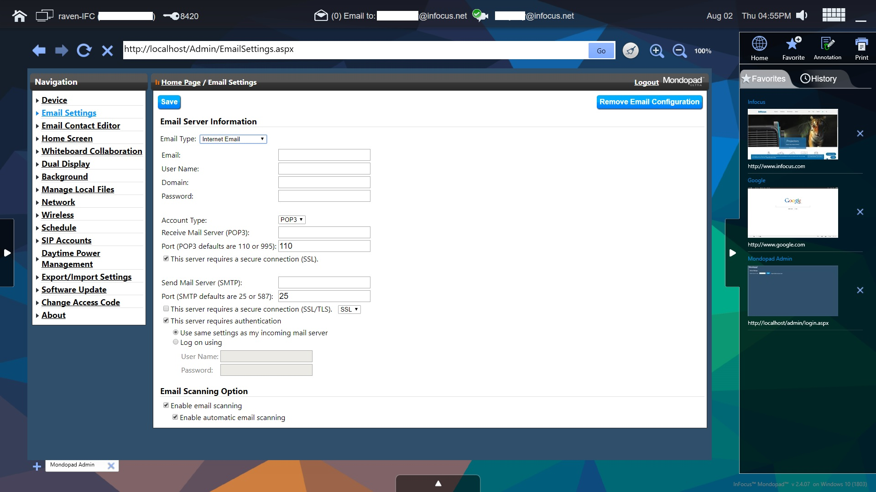
Browser Screen
Browser Admin Email Settings
Admin Email Server
Internet Email
Manual account setup depending on specific setting of internet email service.
See Internet Email Service website for setup.

Slide 22
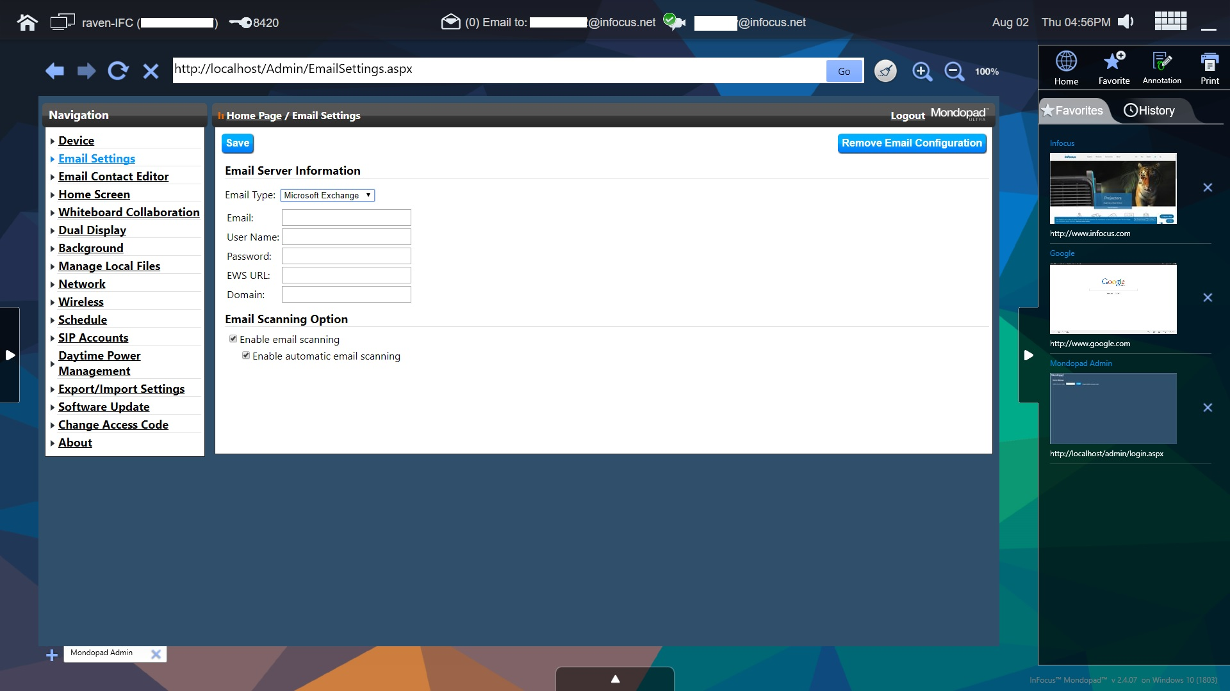
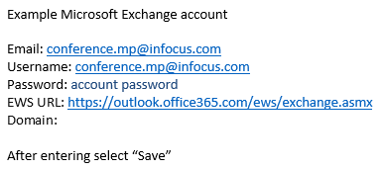
Browser Screen
Browser Admin Email Settings
Admin Email Server
Microsoft Office 365 or Exchange Account Email
Manual account setup depending on company specific setting of service.
Contact Company IT department for account and setup details.
Note: Exchange account requires the account is setup as a EWS

Slide 23
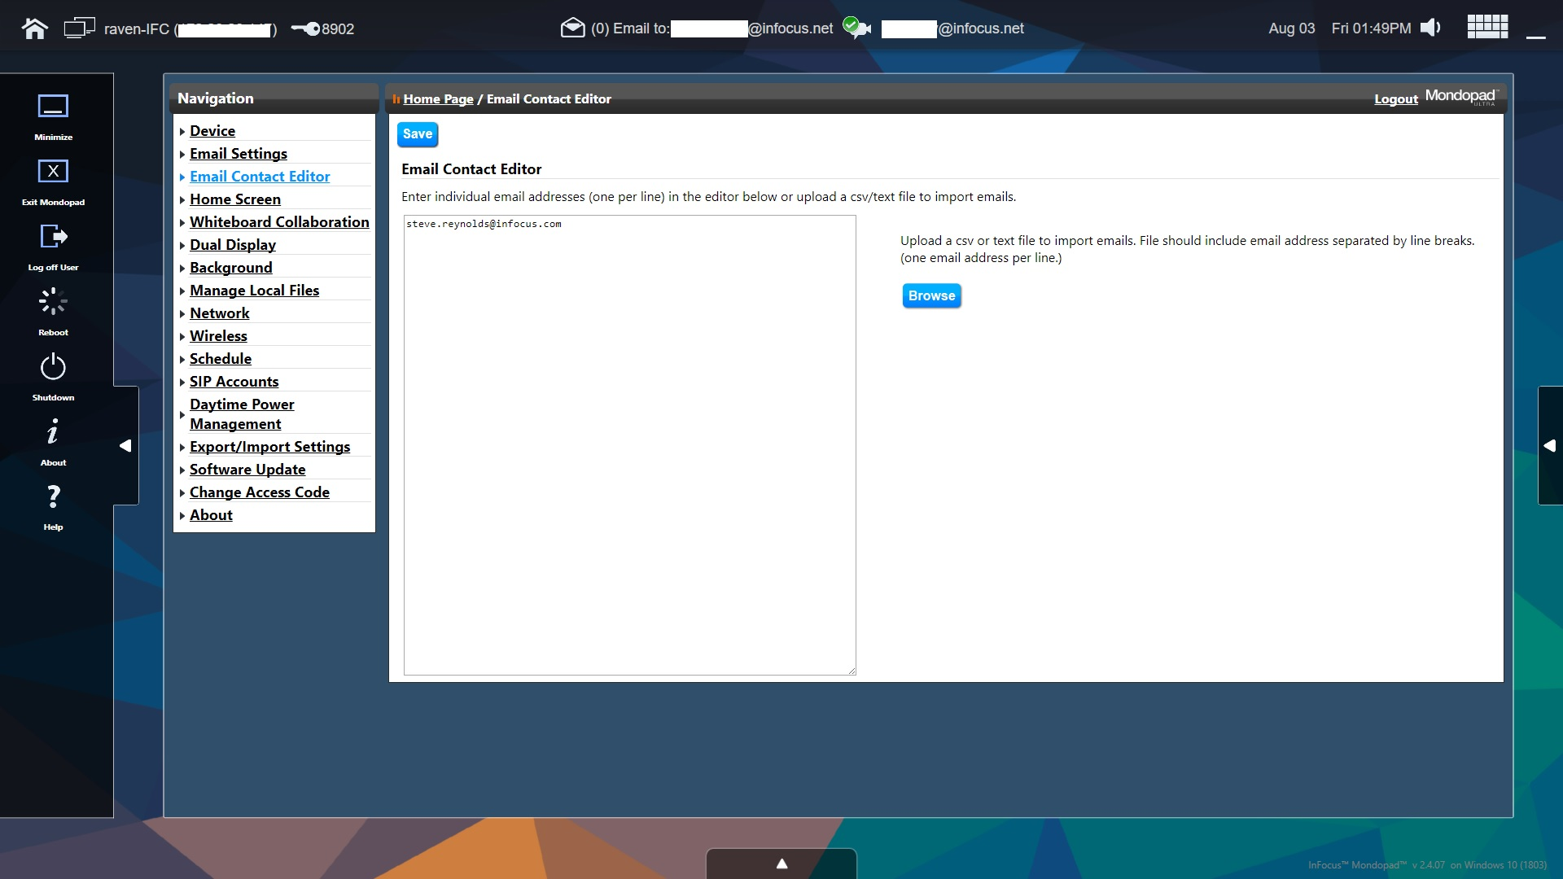
Browser Screen
Browser Admin Email Contact Editor
Admin Email Contact Editor
You can manually enter email addresses in the left side window separate entry for each
You can import a CSV or text file list to import email contacts.
Note: import file should include email address separated by line breaks (1 email per line in the file)

Slide 24
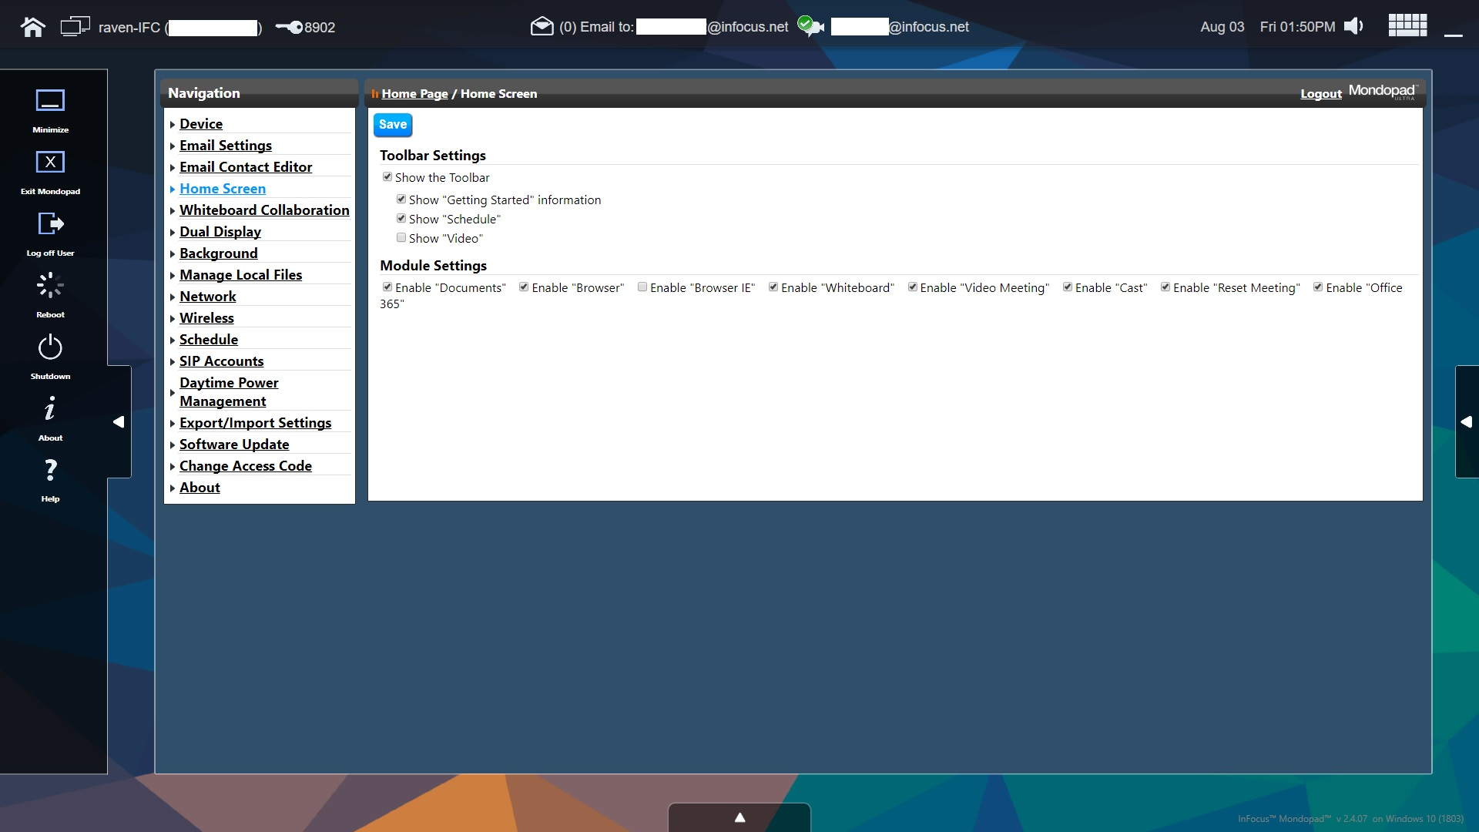
Browser Screen
Browser Admin Home Page
Admin Home Screen
Show the toolbar
if unchecked none of the 3 items in the list show up on the home page
Show “Getting Started” either shows or hides the ICON on the home page
Show “Schedule” either shows or hides the ICON on the home page
Admin Home Screen
Show the toolbar
Show “Video” either shows or hides a small image video that plays on the home page.
If checked options are “Auto Play”, Upload Video (customer own video Max size 2GB) and Video Name (name of uploaded video)

Slide 25
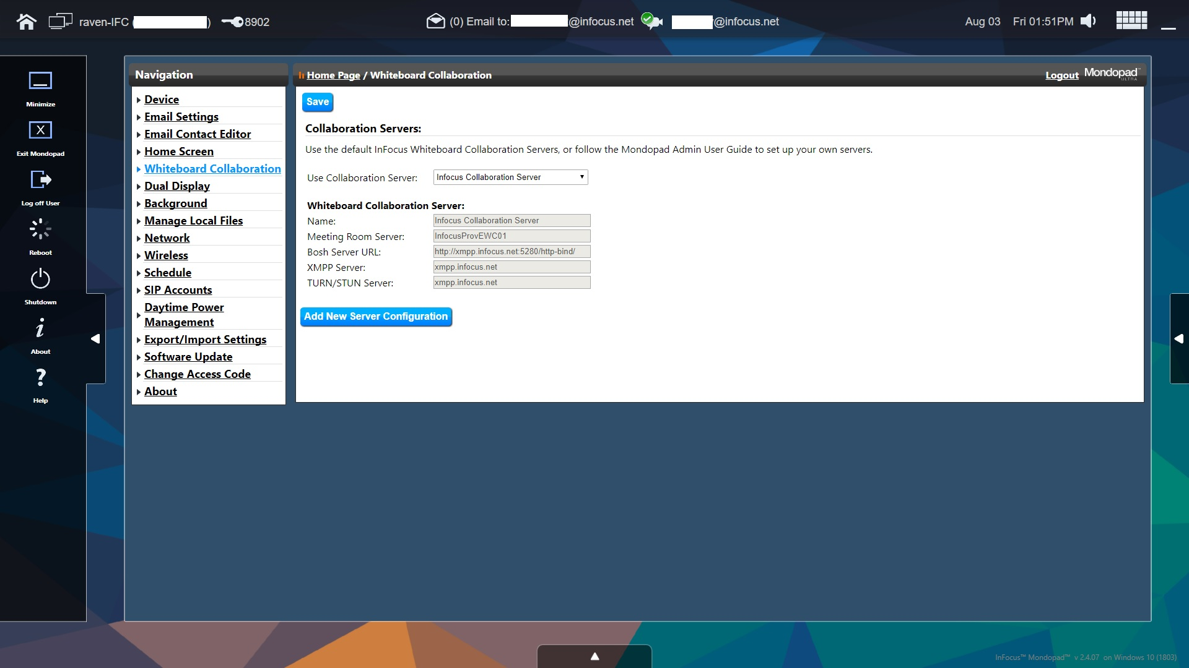
Browser Screen
Browser Admin Whiteboard Collaboration
Admin Whiteboard Collaboration
Collaboration Server
Leave this alone. It will default to the CONX infocus.net bridge account if customer is using infocus.net
Whiteboard Collaboration Server
Leave these fields alone.
Note: These options will be available for changing for customers with Onsite Premise CONX Servers

Slide 26
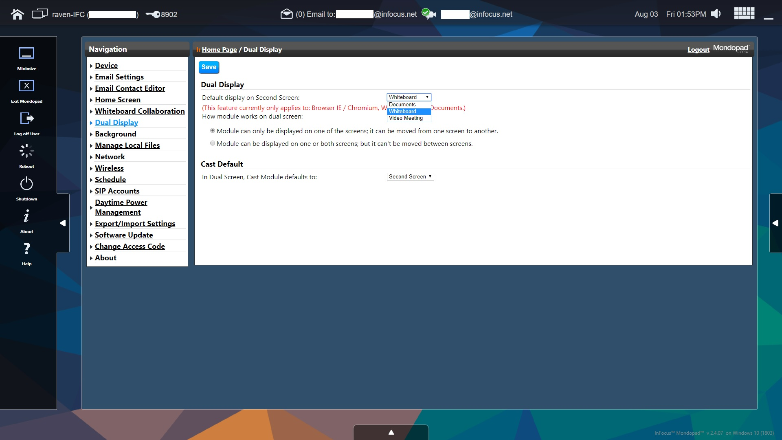
Browser Screen
Browser Admin Dual Display
Admin Dual Display
Dual Display
Default Display on Second Display:
Whiteboard, Documents or Video Meeting
Option radio buttons:
Module can be displayed only on 1 screen but moved
Module can be displayed on both screens at the same time but not movable
Cast Default
In Dual Display Cast Module defaults to either the Second display or the Primary display

Slide 27
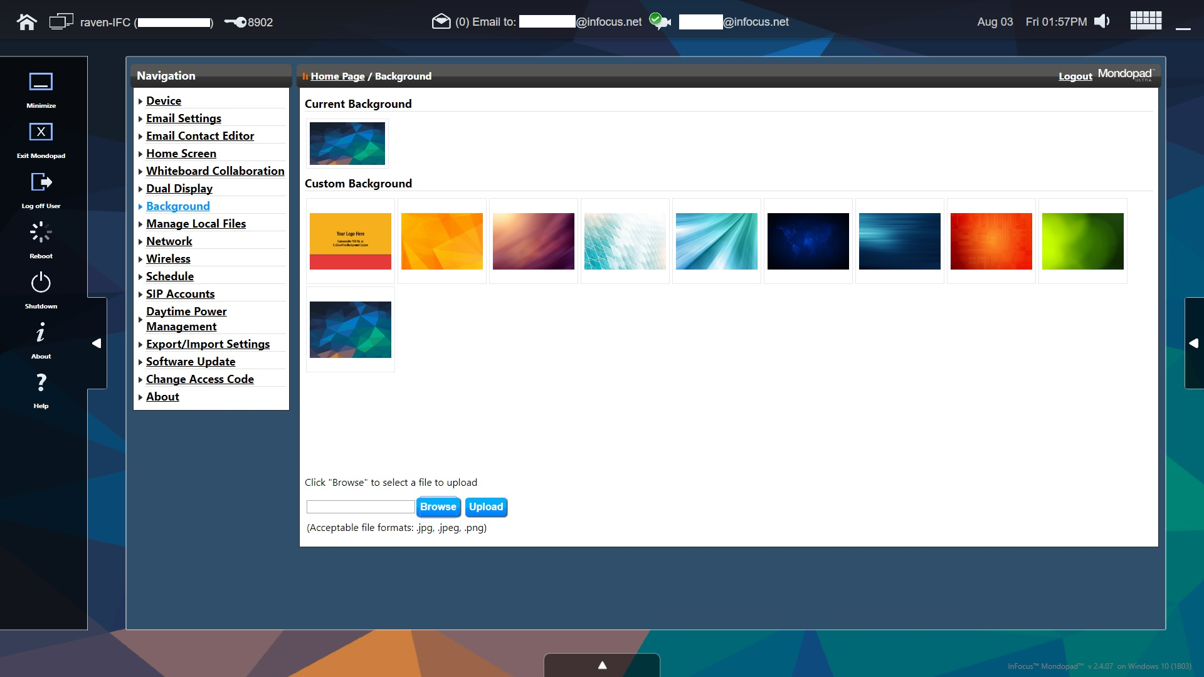
Browser Screen
Browser Admin Background
Admin Background
Current Background shows selected background in use
Custom Background shows available uploaded background screens the customer can select as their default
Upload Customer Custom Background (depending on panel the image should be 4k or 1080) acceptable formats .jpg, .jpeg and .png

Slide 28
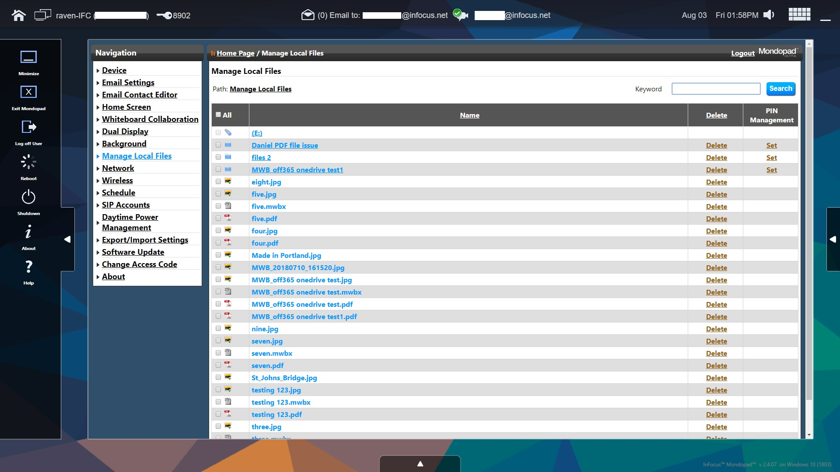
Browser Screen
Browser Admin Manage Local Files
Admin Manage Local Files
Allows Admin to set pins for folders as well as perform manual file management cleanup as necessary

Slide 29
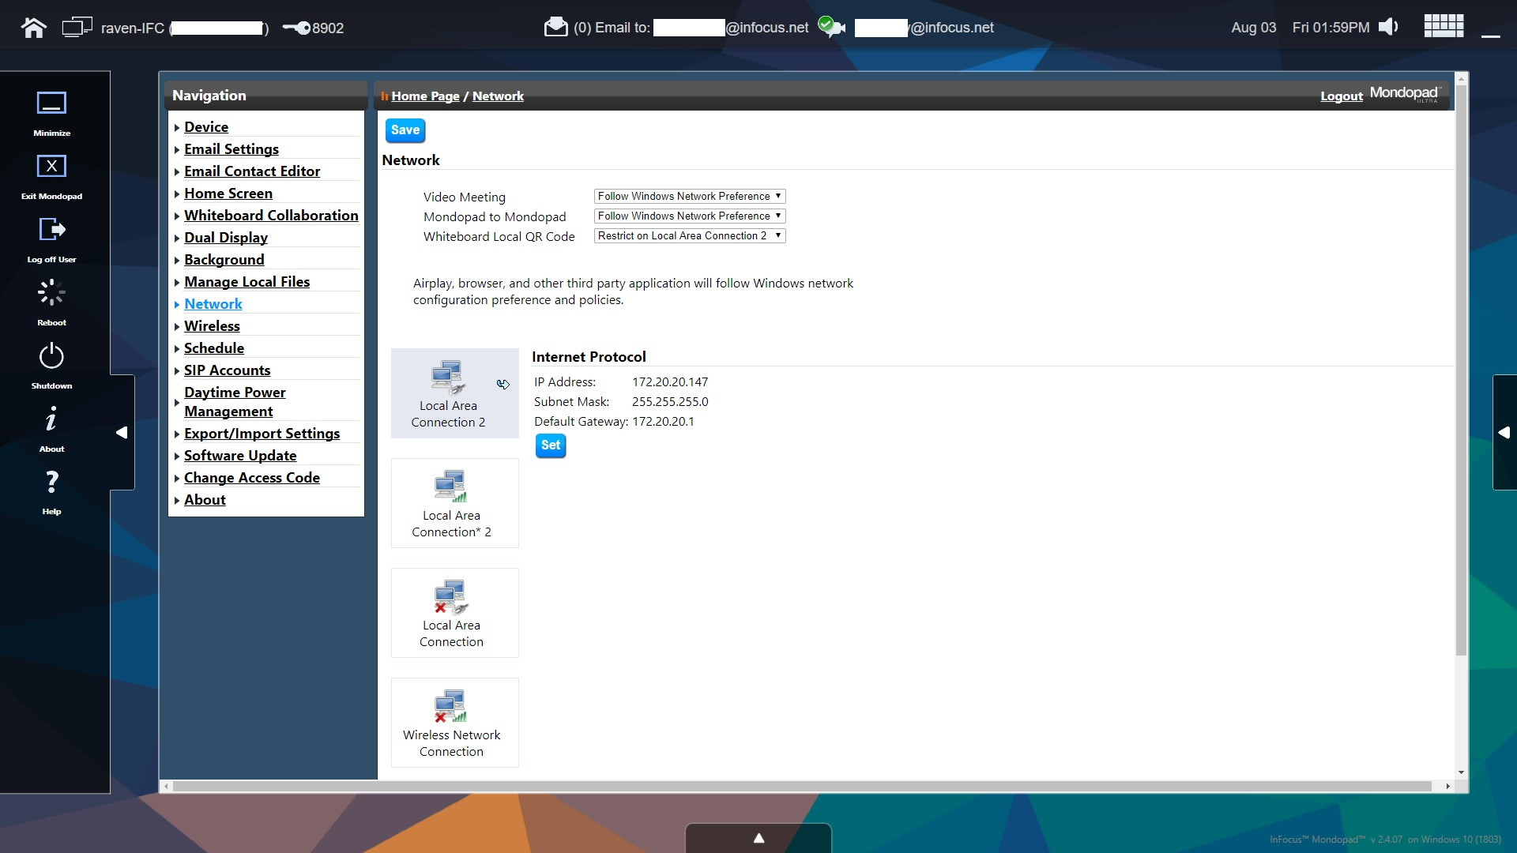
Browser Screen
Browser Admin Network
Admin Network
Network settings should not be managed through this portal.
Have the customer configure the Network settings through Windows and it will pass through to Mondopad.
Admin Network
There are though three functional options that can be set:
Video Meeting traffic – ether Follow Windows preferences or set to Lan or WiFi
Mondopad to Mondopad Invite traffic – ether Follow Windows preferences or set to Lan or WiFi
Whiteboard local QR Code traffic – ether set to Lan or WiFi

Slide 30
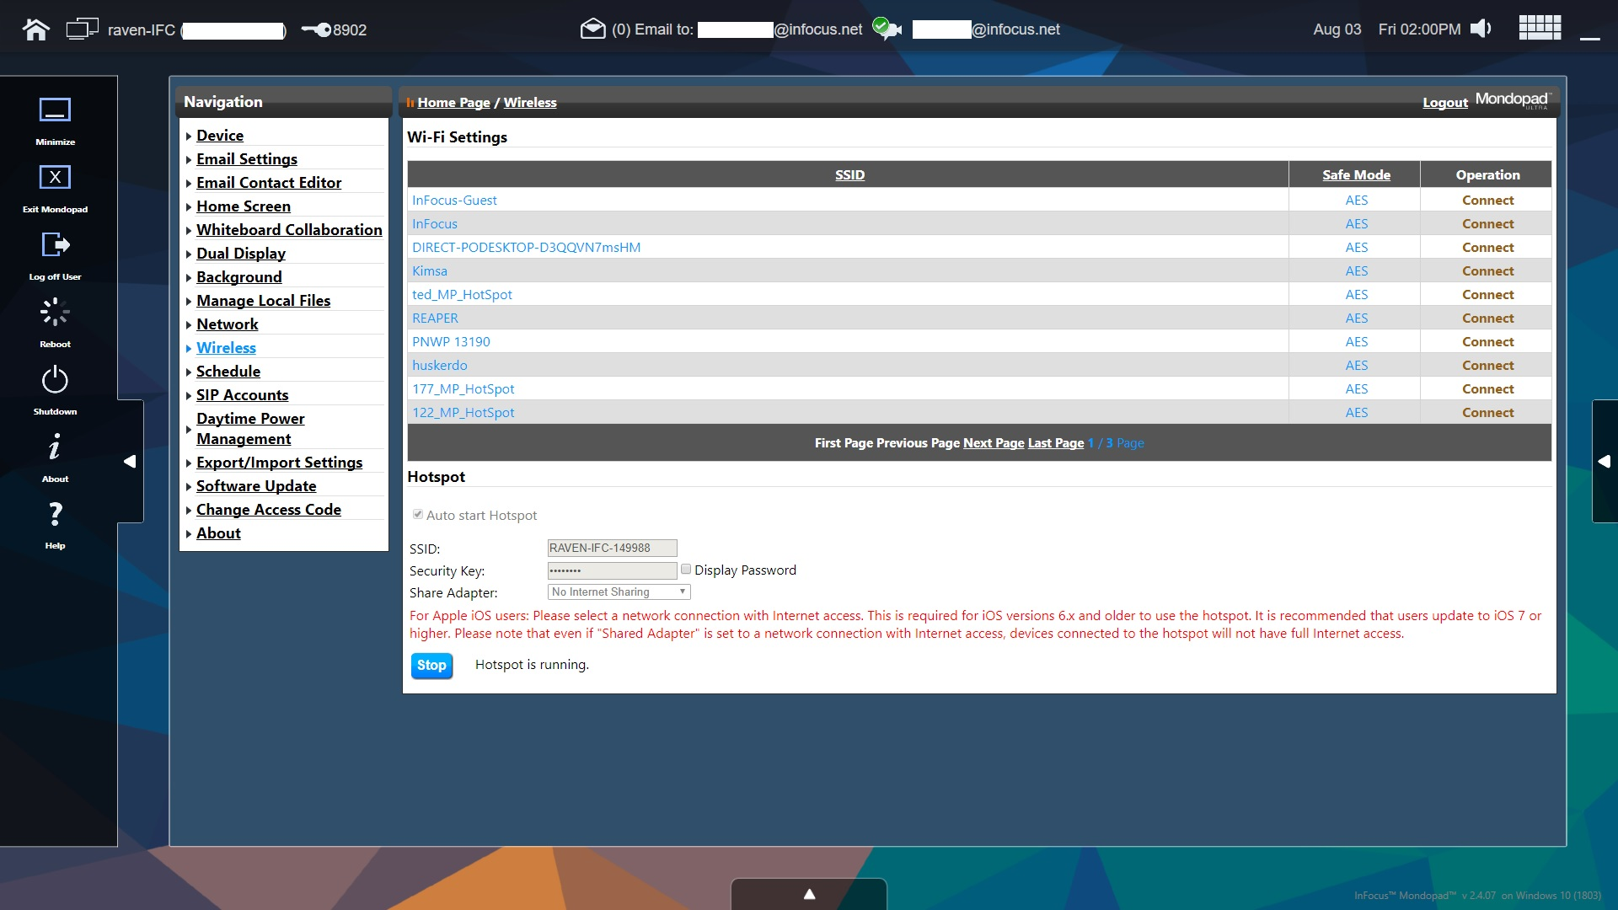
Browser Screen
Browser Admin Wireless
Admin Wireless
Shows if Mondopad Hotspot is running and also the user to stop the Hotspot to change its name or settings.
SSID: Name the Hotspot broadcasts
Security Key: External device connection access code
Share Adapter: Changed from No internet sharing to any the available networks if connecting with older IOS devices. IOS 7 or above does not require this.
Admin Wireless
Show available WiFi connections and if connected shows which Mondopad is connected to.

Slide 31

Browser Screen
Browser Admin Schedule
Admin Schedule
Setup with Microsoft Exchange or Office 365 account details. The account should be unique setup specifically for this Mondopad.
Used to show Mondopad schedule

Slide 32
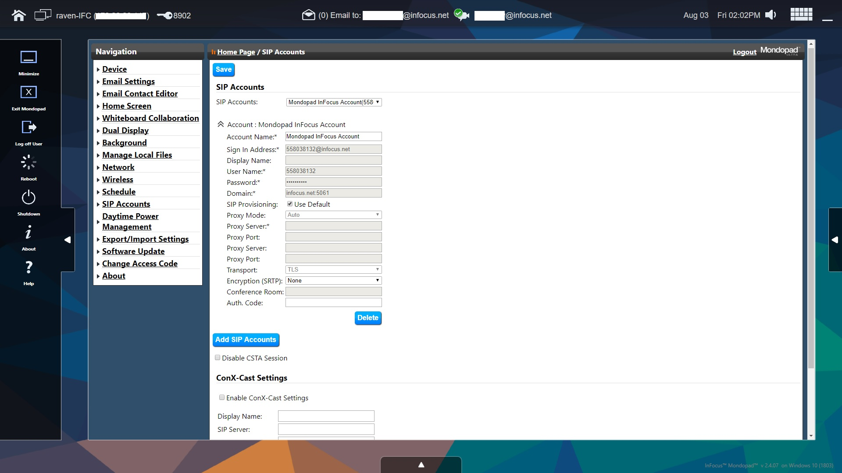
Browser Screen
Browser Admin SIP Accounts
Admin SIP Accounts
Default is Mondopad InFocus Account (auto provisioned infocu.net
Can select Add SIP Account button to add their own SIP account service information if they use another SIP service.
If Account is having troubles registering or making calls try changing the SIP Provisioning check box to unchecked. Then change the Transport from TCP to TLS and select “Save” at the top. Now retry

Slide 33
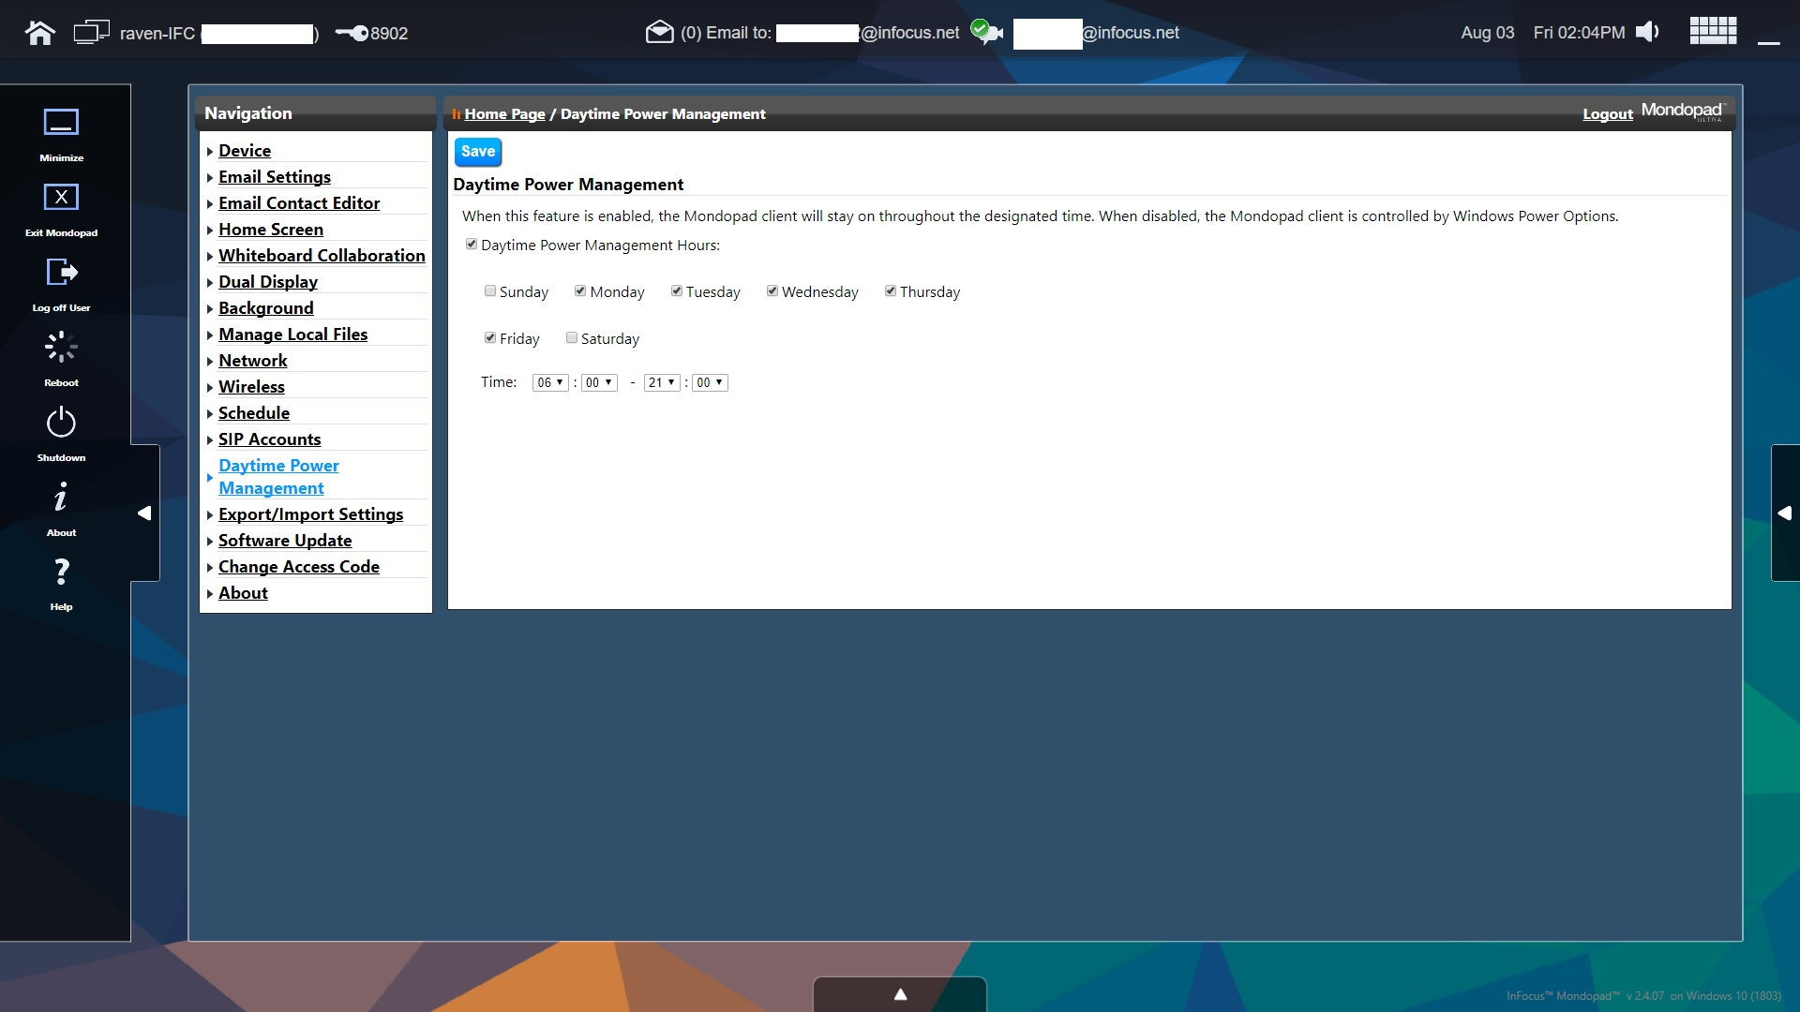
Browser Screen
Browser Admin Daytime Power Management
Admin Daytime Power Management
Daytime Power Management Hours checkbox:
If unchecked Mondopad power management is disabled
If checked enables Mondopad Daytime Power Management Keep Alive heartbeat to Windows.
Admin Daytime Power Management
Check the Days and hours that it will be active.
Time:
First is the start time Second is the stop time
Between these hour ranges the keep alive heartbeat will be active.
After and before the Time range the system defaults to Windows Power Management settings.

Slide 34
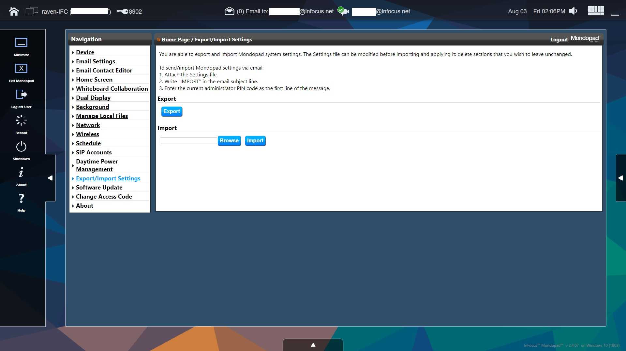
Browser Screen
Browser Admin Import/Export Settings
Admin Import/Export Settings
Export Button exports the Browser Admin settings to a Microsoft Excel Spreadsheet.
Requires Microsoft Excel is installed
Exports everything except SIP and EMAIL settings which need to be unique per Mondopad
Admin Import/Export Settings
Import Button imports a previously exported Mondopad settings Excel file to setup the Mondopad with the settings saved to the exported file used.

Slide 35
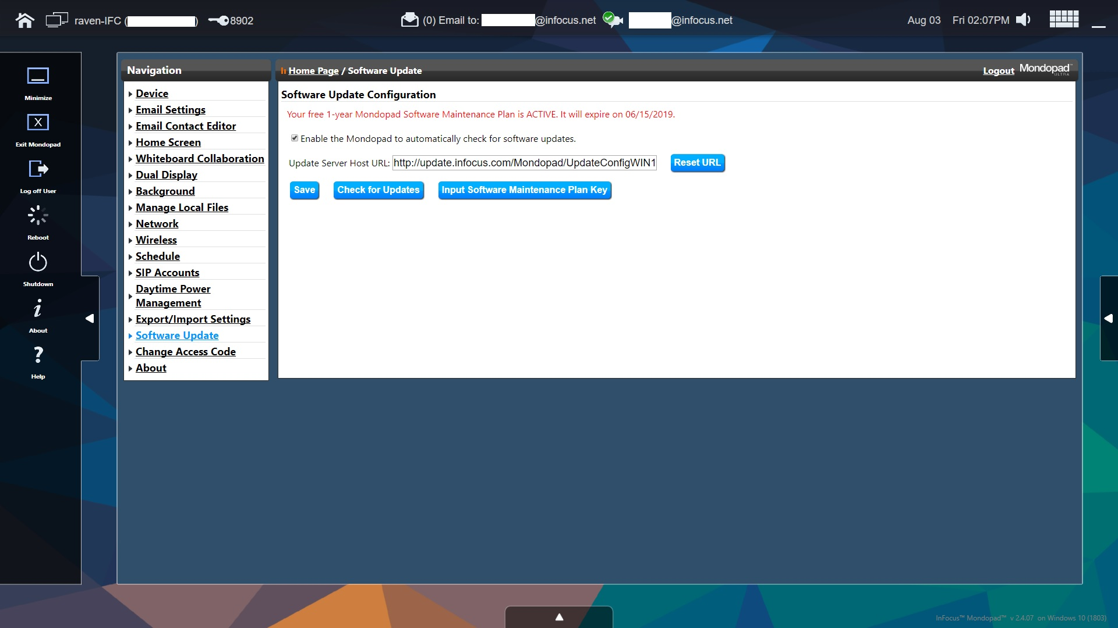
Browser Screen
Browser Admin Software Update
Admin Software Update
Mondopad Software Update Configuration
Informs user status of their Mondopad Software Maintenance Plan either Active or Expired
Update Server URL – Do not change – if this is changed it can be Reset to defaults by selecting the Reset URL button
Admin Software Update
Check for Updates goes out to the update server and checks for Mondopad Software Application suite updates and if the license is active asks if the user wants to install the update
If the license is expired and the customer purchases a license key the “Input Software Maintenance Plan Key” button allows them to enter the key and reactivate the plan.

Slide 36
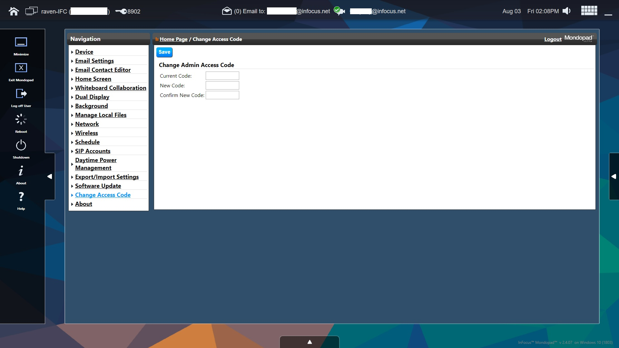
Browser Screen
Browser Admin Change Access Code
Admin Change Access Code
Change Admin Access Code allows the user to set their own administrative access code to limit access to changing settings.
Default access code is 1111

Slide 37
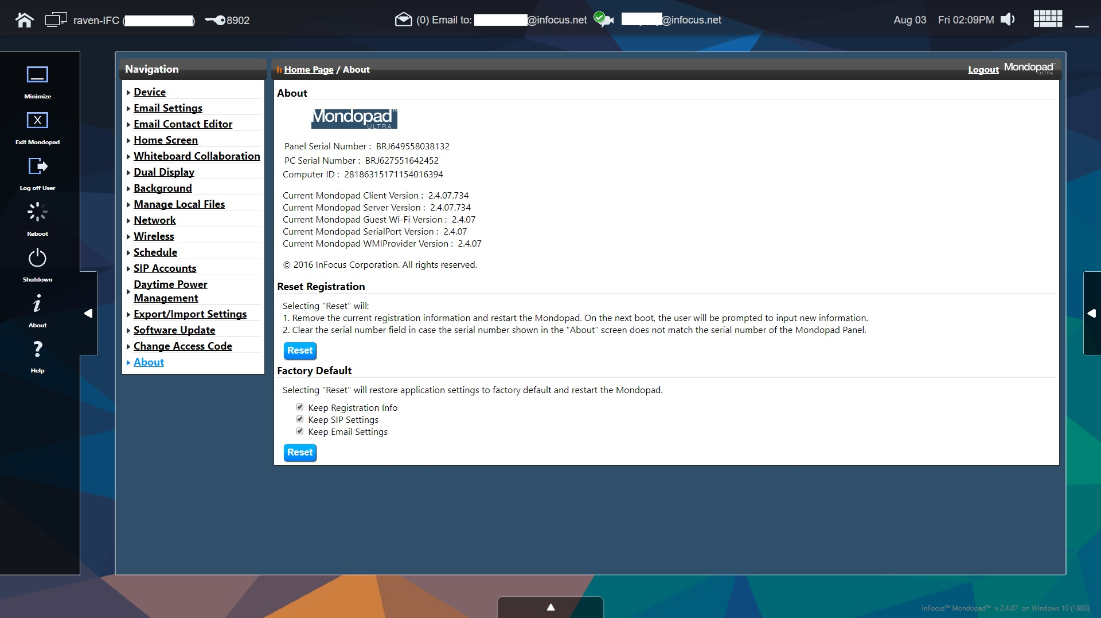
Browser Screen
Browser Admin About
Admin About
Mondopad Serial Number used for Auto Provisioned SIP and Email
Mondopad Software Module Versions
Reset Registration
Resets the Mondopad Registration and clears the Mondopad Serial number.
The seral number should pull from the BIOS if not enter the Mondopad Serial Number and select “Save”
Admin About
Factory Default
This option by default Saves the registration, SIP and Email settings.
This can be run while removing any of these values by unchecking one or all of the following:
Keep Registration info
Keep SIP Settings
Keep Email Settings

Slide 38
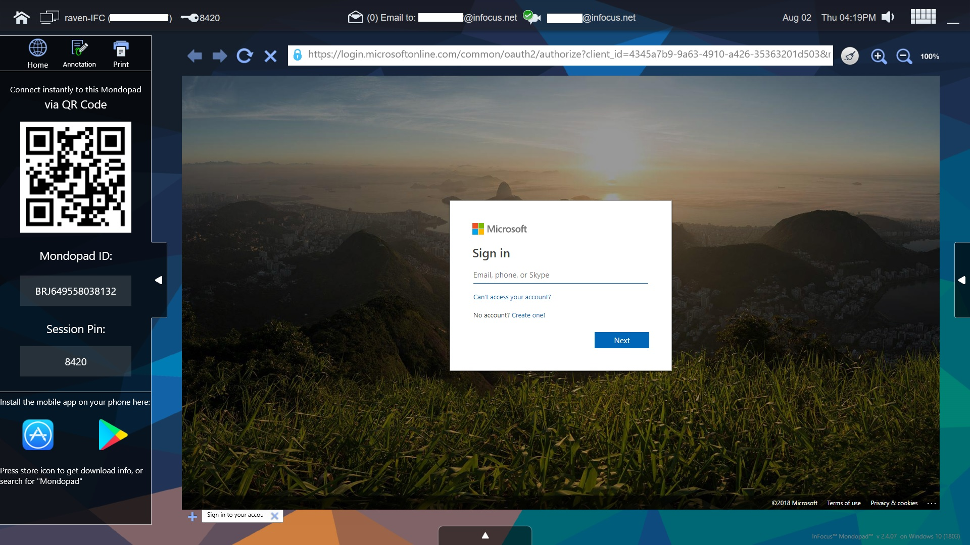
Office 365 Screen
Office 365
Office 365 Sidebar
Home, Annotation, Print
QR Code Scan to mobile app
Mondopad Serial Number ID
Session access code
Links to QR Code for Mondopad Office 365 Login Application Apple App store and Android Play store
Click on Store Icon to get download info

Slide 39
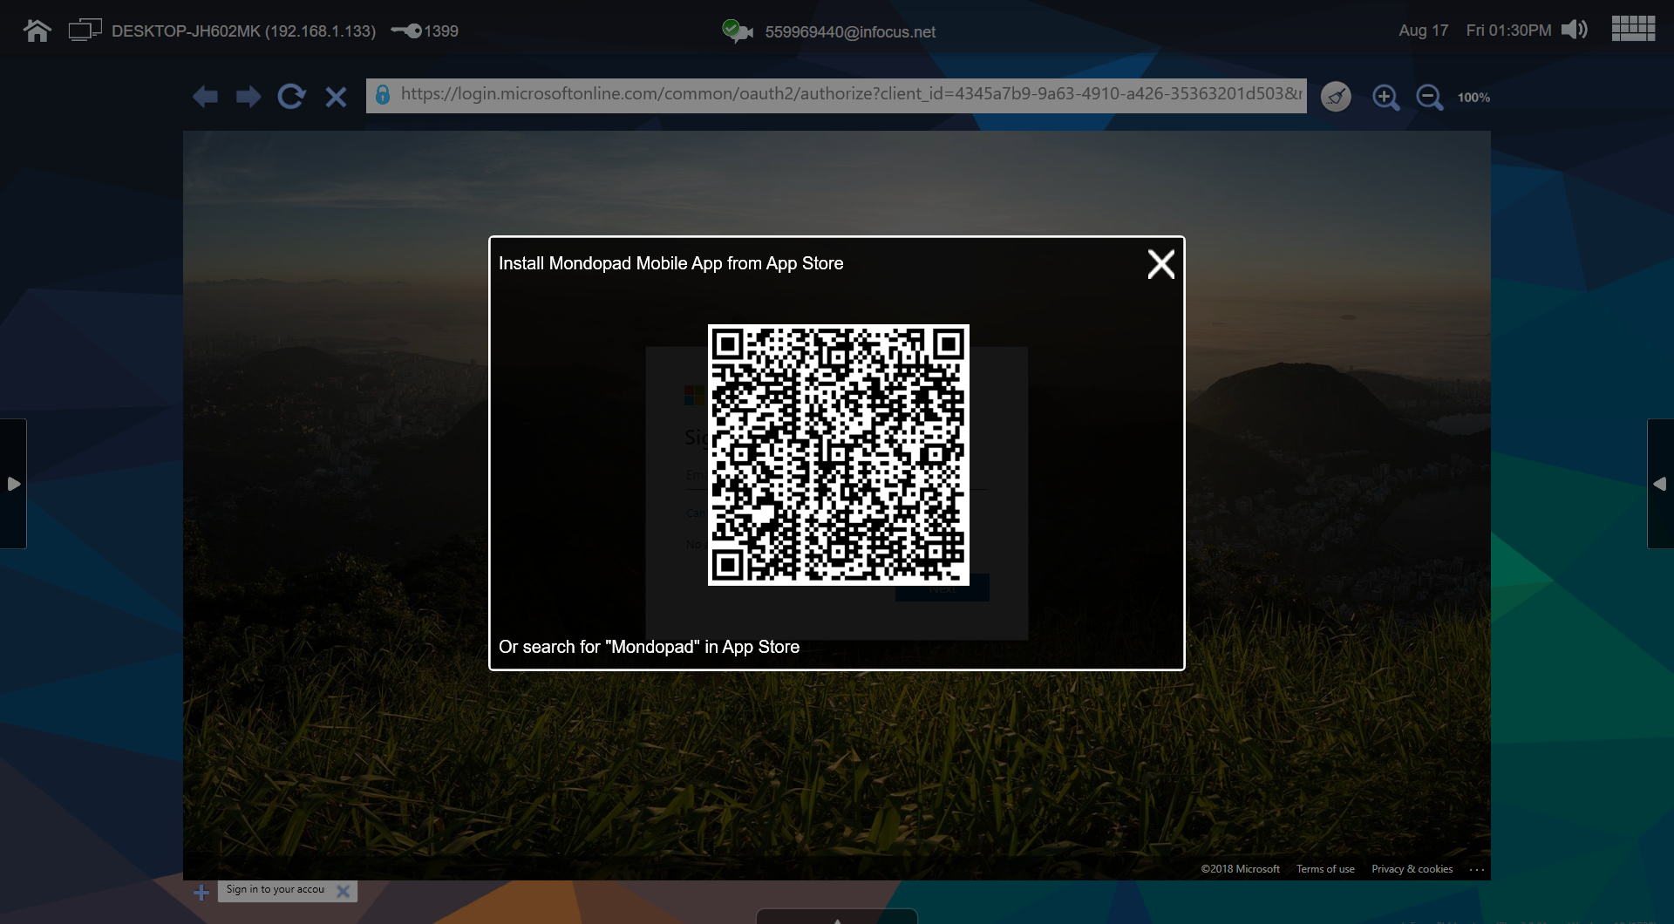
Office 365 Screen
Mondopad Mobile App – Find App
via QR Code
Use QR Reader to find the Mondopad Mobile App in the Apple App Store or Google Play
via Search
Enter “Mondopad” in The App Store or Google Play to find the Mondopad Mobile App

Slide 40
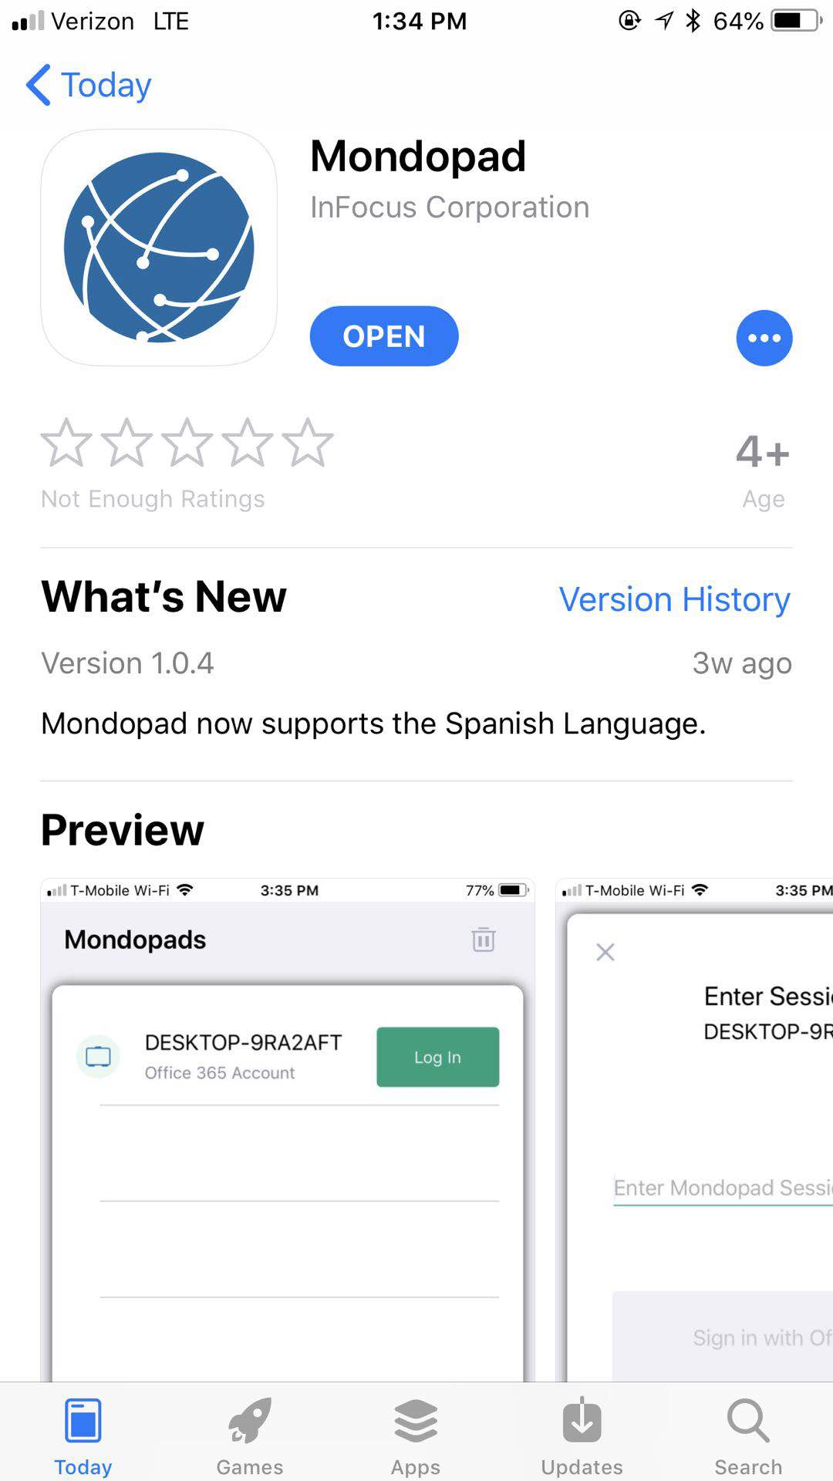
Office 365 Screen
Mondopad Mobile App in App Store

Slide 41
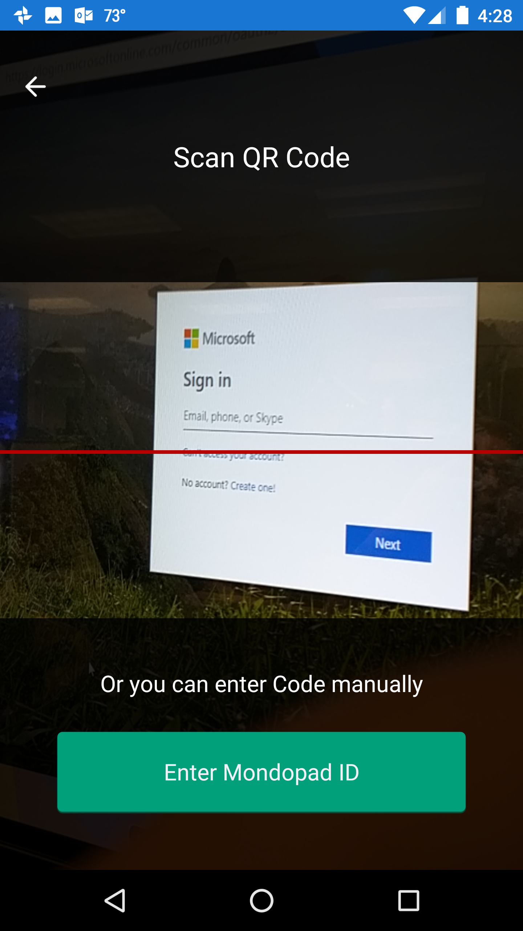
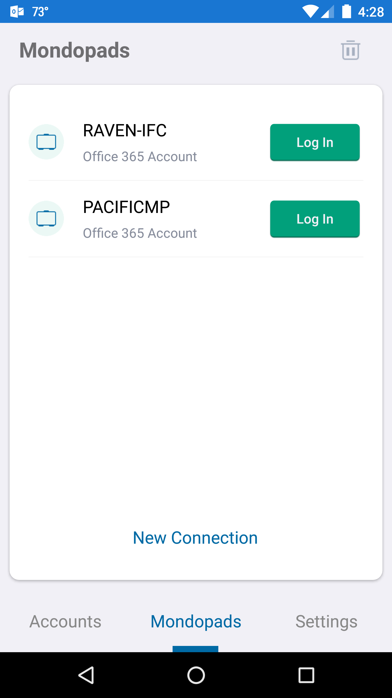
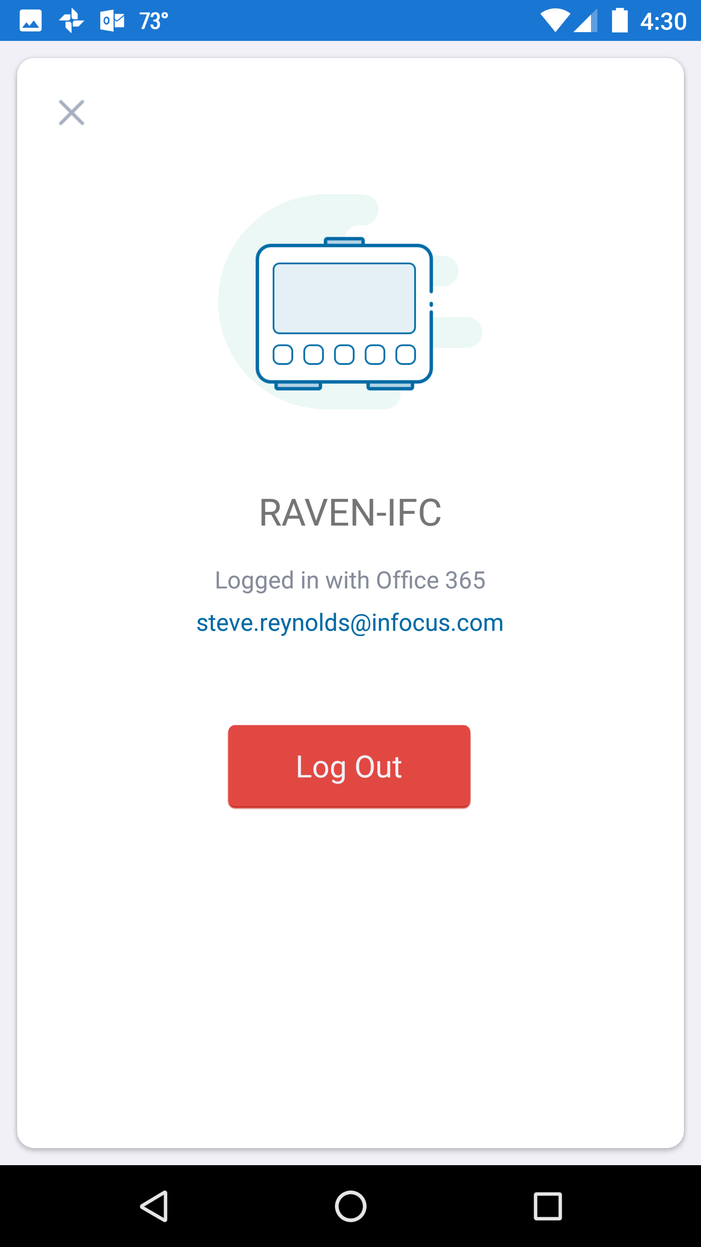
Office 365 Screen
Office 365
Office 365 Phone App
Once you have the Mondopad Office 365 Application installed on your phone you will have to setup the application with your login ID and password
Once setup you can easily use your phone to log your account into the Mondopad Office 365 tab by using the built in QR scanner function to scan the Mondopad and connect.
Once scanned the app remembers the Mondopad and provides a list to select from.
When done simply Log out from either the Phone app or the Office 365 sidebar.

Slide 42
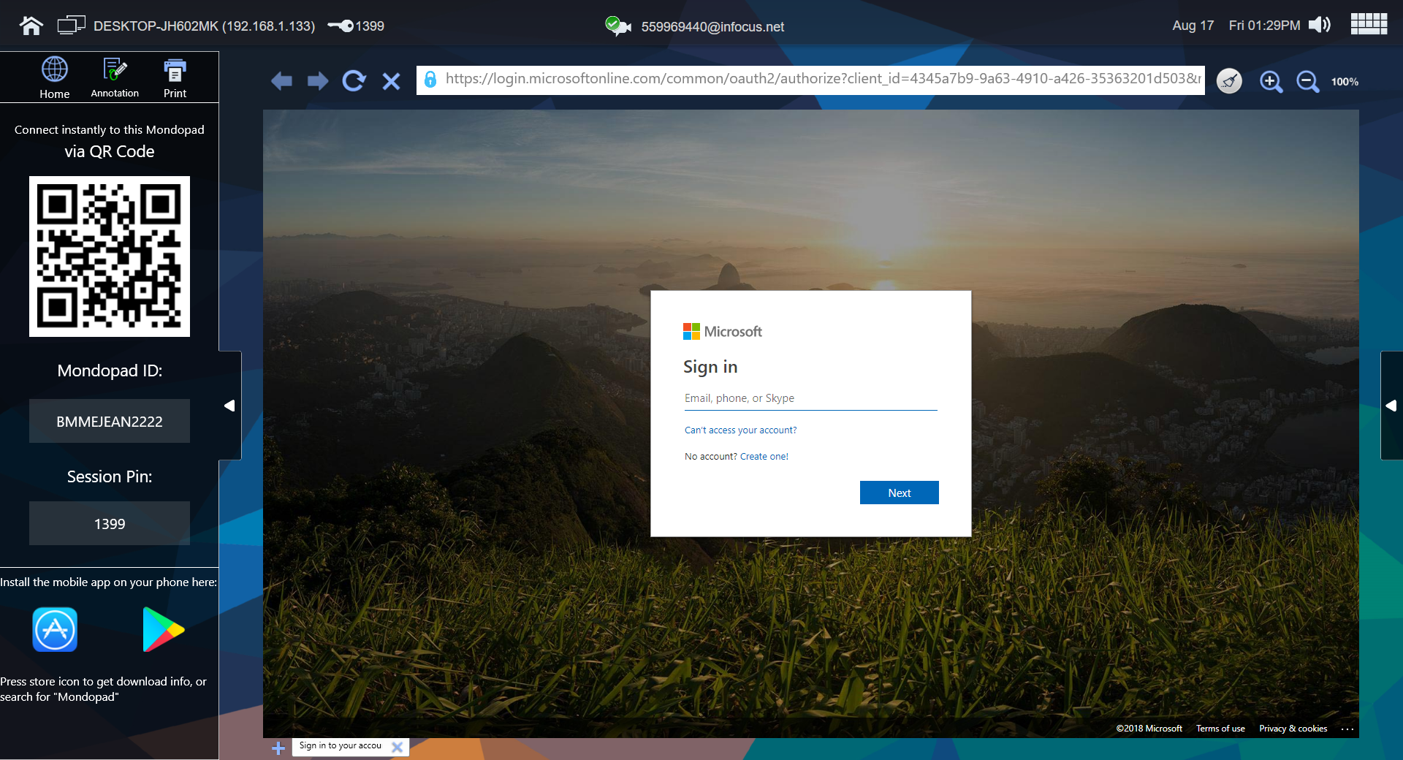
Office 365 Screen
Office365 Module – Logging in
via Mobile App
Two ways to Pair:
via QR code: QR scanner is included in the app
via Manually enter the Mondopad ID (case insensitive)
User does not need to be in the same network as Mondopad to pair with it
Once paired, user must enter Session Pin to connect to it and log in.
From Mondopad
Log into Office365 directly from the this page on Mondopad

Slide 43
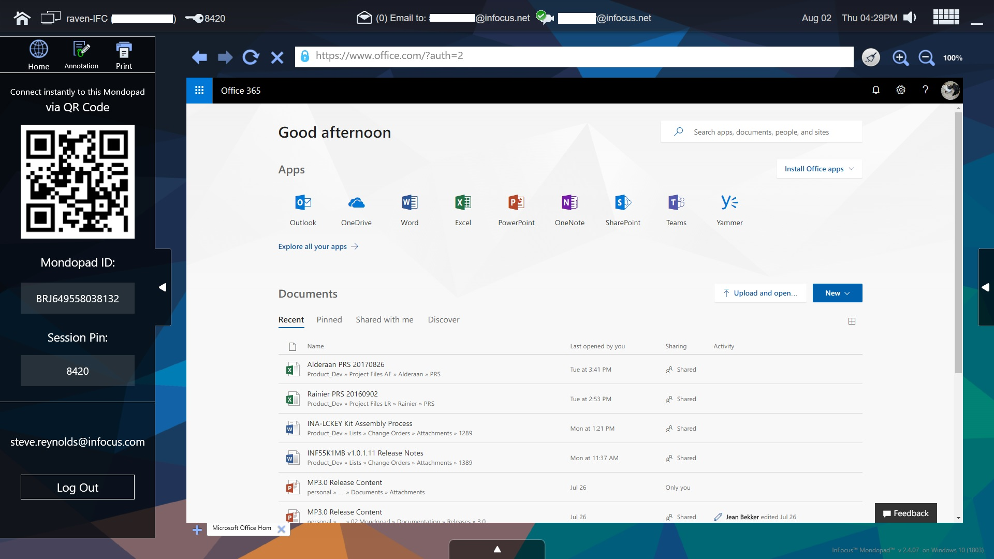
Office 365 Screen
Office 365
Office 365
Once logged in to your Office 365 account you have full access to all your online Microsoft applications
You are able to open separate tabs within

Slide 44
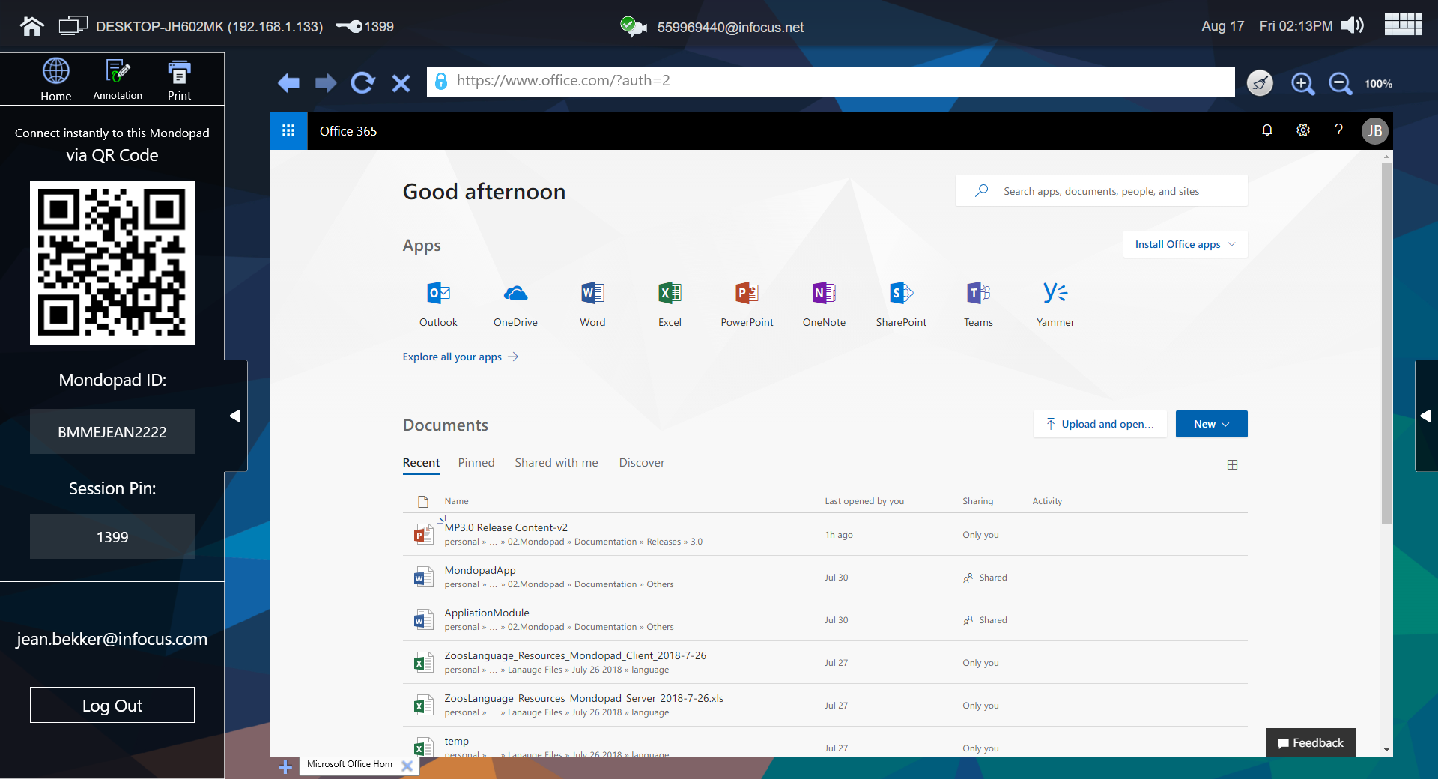
Office 365 Screen
Office365 Module – Logged In
Office 365 Apps
Default landing page is per Office365 configuration
All Office365 apps work here with the exception of Team
Calendar Alerts
Alert shows upcoming events in Office365 Calendar
121 Call links in alert will launch directly in Mondopad ConX module if it is enabled
Support Skype4Business Call Events too. Launch Skype4Business app if installed, or the web app if desktop app is not installed.
Side bar
Once logged in, side bar by default is hidden.
Shows the logged in user name.

Slide 45
Office 365 Screen
Office365 Module – Log Out
Log Out
Manually, via
Office365 web page
Mondopad Sidebar Log Out button
Mobile App Log Out button
Automatically, via
Meeting Reset
Mondopad Restart/Shut down
If you are currently logged in while another person tries to log into the same Mondopad via mobile app, you will be automatically logged out
Security
All tabs will be closed
Once Logged out, you will need to re-enter user name and password to log back in. It does not retain your user name.

Slide 46
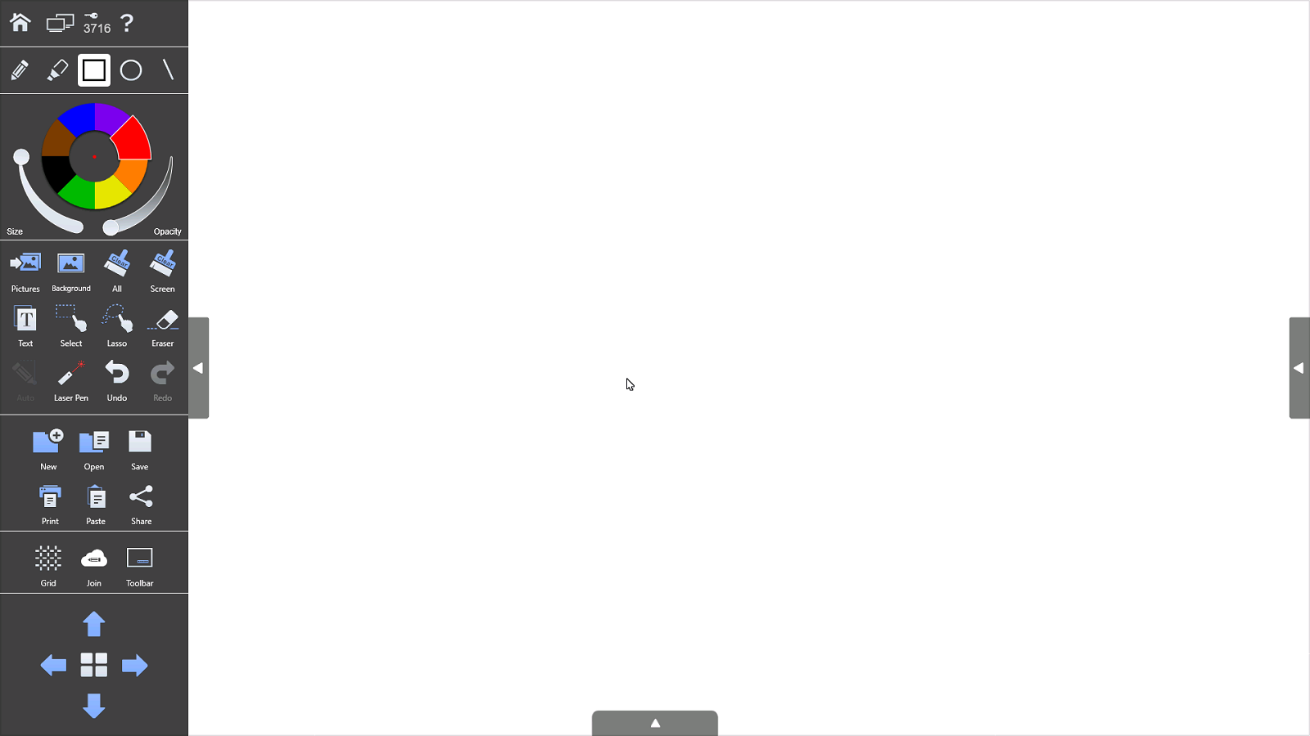
Whiteboard Screen
Whiteboard
Whiteboard
Home, MP-MP Invite, Admin Key, Help
Pen, Highlighter, Rectangles, Circles and Lines Select
Pen/Highlighter Color Select
Import Picture, Import background, Clear All Pages, Clear Current page screen, Text, Select/Lasso, Erase, Laser Pointer, Redo/Undo
New Whiteboard
Open exiting Whiteboard file
Save as (Whiteboard, JPG or PDF either current view or whole Whiteboard canvas pages)
Whiteboard
Print
Paste
Share (JPG or PDF current or whole view to email list or QR code)
Grid (grid overlay does not save)
Whiteboard Cloud (connecting to other Mondopad units and collaborating on shared Whiteboard)
Toolbar (onscreen popup toolbar on or off)
Whiteboard canvas page selector/add pages

Slide 47
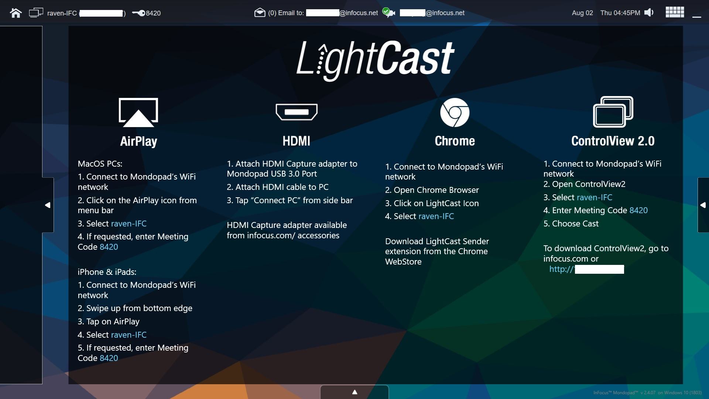
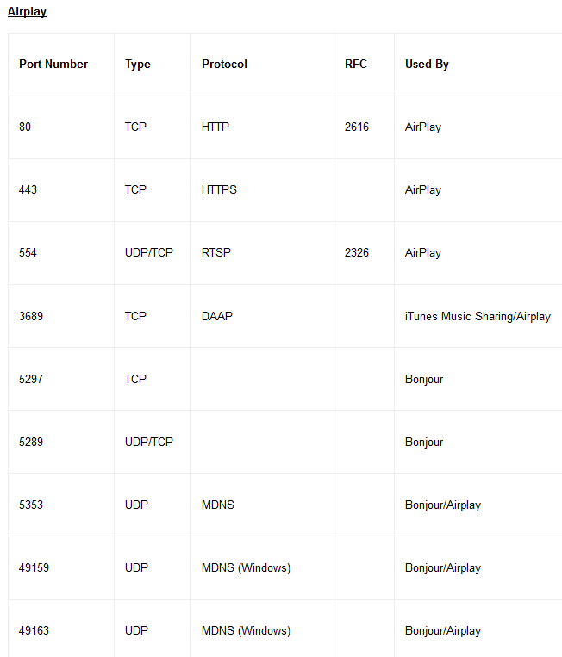
Cast Screen
Cast - Airplay
Cast
Casting from Airplay requires that it is enabled in the Browser Admin
Airplay requires that the two connecting devices are on the same subnet
.
The Ports shown in the chart on the right provides the Ports required for Airplay connectivity

Slide 48
Cast Screen
Cast - HDMI
Cast
Casting using HDMI requires the purchase of a Magewell USB 3.0 HDMI Video Capture Dongle which connects to the USB 3.0 port on the PC module.
There are several ways to use this device:
Cast HDMI from a source via wired HDMI
Wirelessly connecting a SimpleShare to the HDMI port on the Magewell
.

Slide 49
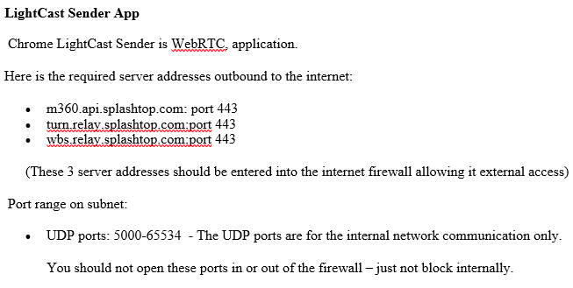
Cast Screen
Cast – Chrome Browser
Cast
Casting using a PC or Chromebook using the Chrome Browser “LightCast Sender” app plugin
App is launched from inside the Chrome Browser and has two tabs 1 send content only and 2 send content and audio
LightCast Sender app requires that specific ports are open on the same subnet the two connecting devices are connected and requires internet access out to three server addresses (see chart on right side)
.

Slide 50
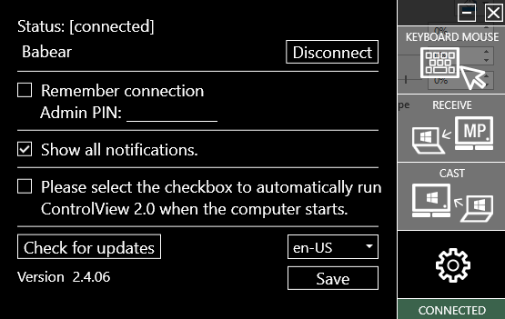
Cast Screen
Cast – ControlView 2
Cast
Casting or Control of the Mondopad from a PC device is possible through the use of a ControlView 2 application that can be downloaded from connecting your PC Browser to the IP Address of the Mondopad on the same subnet.
Once installed when you launch and connect to a Mondopad device you have the option to Cast content with Touch control or Receive where you can control the Mondopad from your laptop or simply Keyboard/Mouse control
.
On PC Side

Slide 51
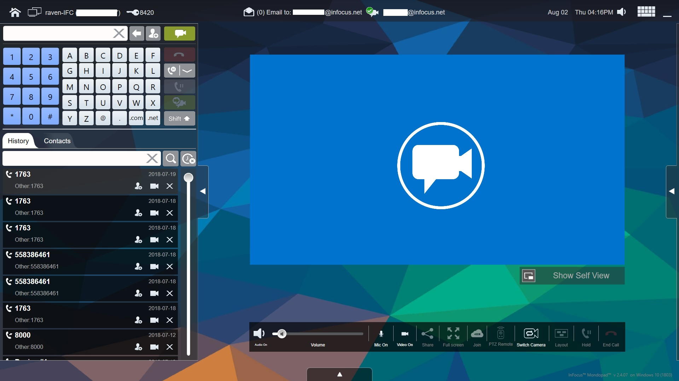
SIP Account Selection List
Initiate SIP Call
Dial Field
Select/Initiate H323, Skype, Skype for Business or Audio Calls
Call Screen
Call Controls
Can Mute Speaker before Call.
Can Mute Camera before Call.
Can show or hide Self View before Call.
Can Mute Microphone before Call.
Action Toolbar
Fades away after 5 seconds of inactiveness.

Slide 52
Whiteboard Cloud Collaboration between Mondopad devices
Initial view is History and Contacts Tab (can be configured in Browser Admin to show Accts, Settings and Statistics)
Optional PTZ Remote Camera Control
Full Screen
With multiple cameras ability to Switch camera feed
Data Share either App or Display

Slide 53
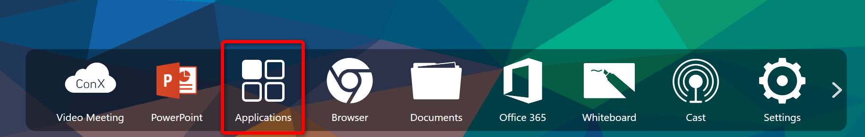
Applications Module
Applications Module
Main Features
(details in following slides)
Listed all 3rd party applications
Added ability to drag and drop any 3rd party application into the Mondopad bottom bar
Added ability to customize the bottom bar by reordering items

Slide 54
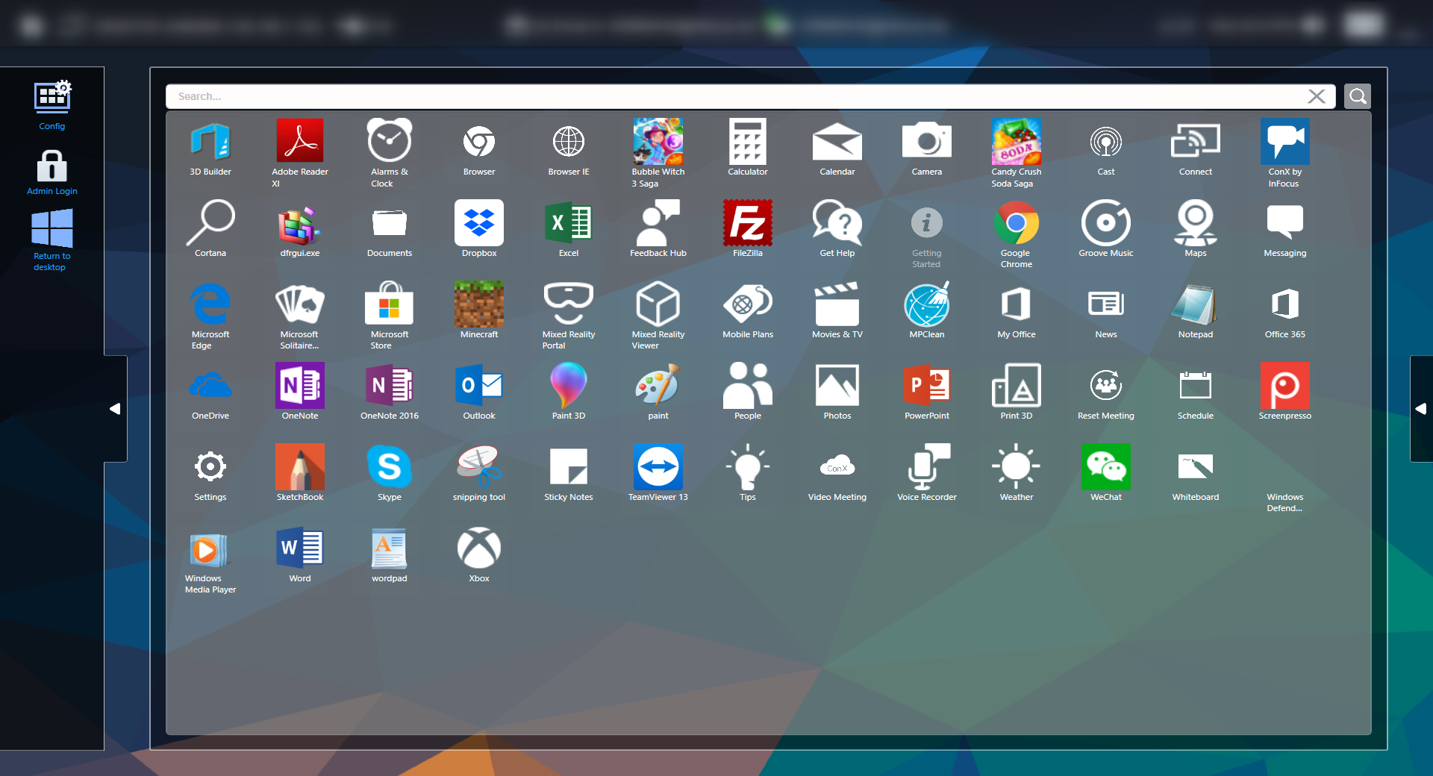
Applications Module
Launching 3rd Party Applications
List of Applications
Show list of applications installed on this system, including Mondopad modules
Launch App
Press app icon to launch the application
Search
Filter as you type
Enter “Mondopad” to show only Mondopad Modules

Slide 55
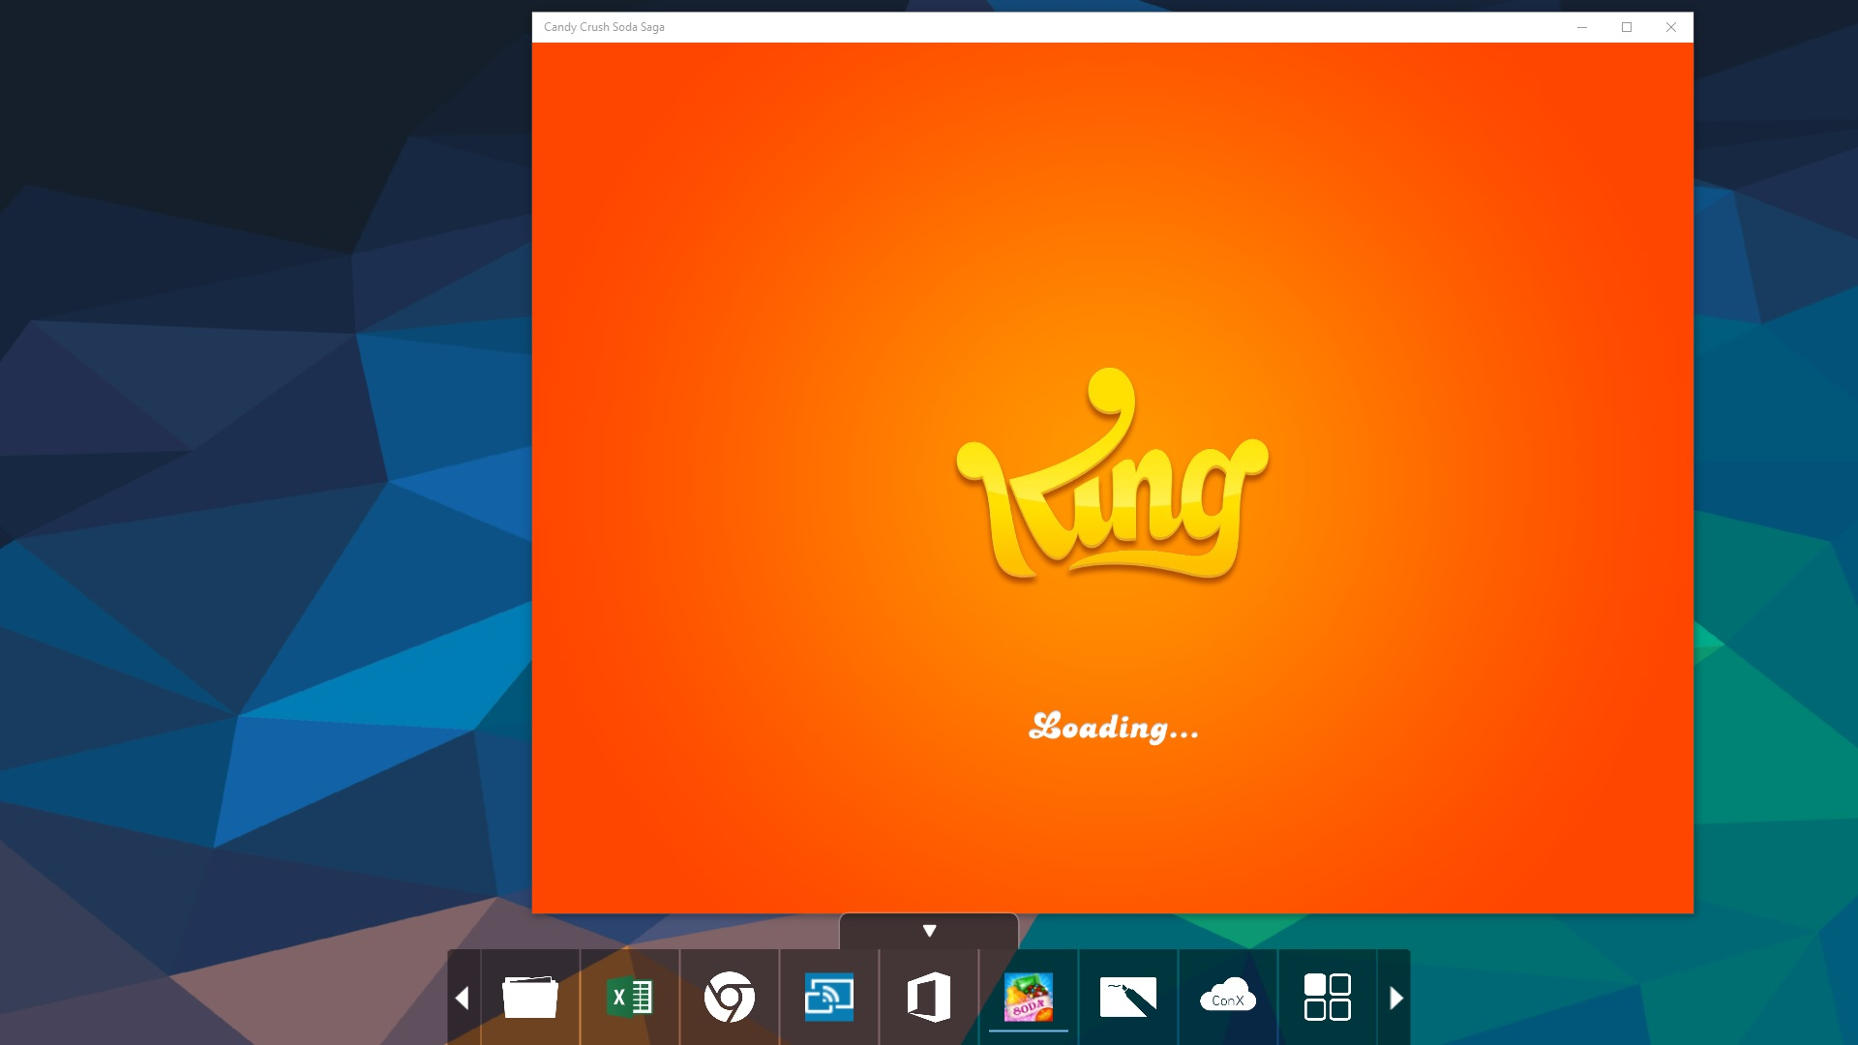
Applications Module
Running 3rd Party Apps – Kiosk Mode
3rd Party Application
Runs on top of Mondopad Background
Return to Mondopad
Click on Home icon from Bottom Toolbar
See All Running Apps
Expand to see all running 3rd party apps (next slide)

Slide 56
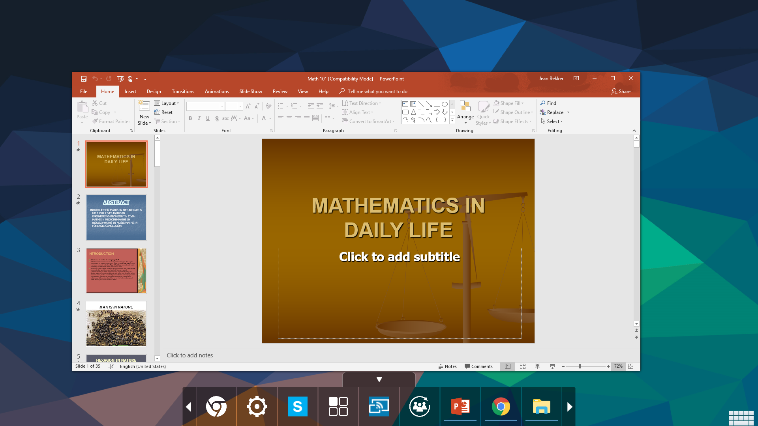
Applications Module
Running 3rd Party App – Kiosk Mode
3rd Party Application
Runs on top of Mondopad Background
Bottom Bar
To return to Mondopad Modules or other 3rd party apps

Slide 57
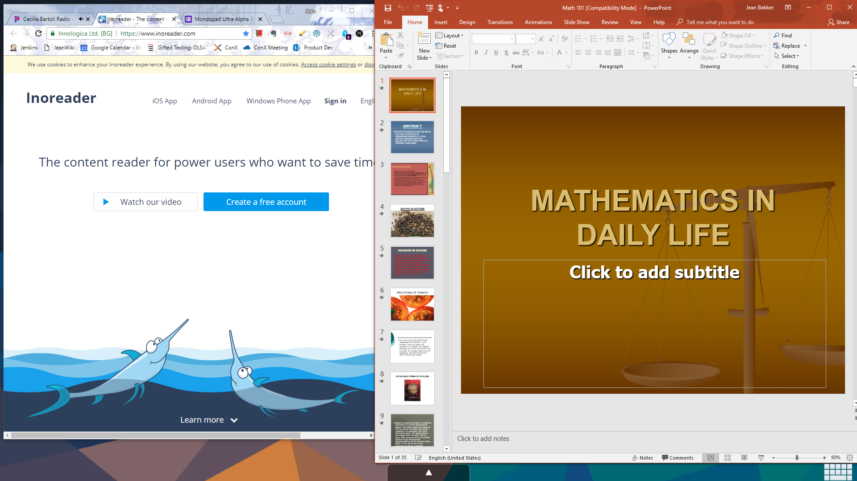
Applications Module
Running 3rd Party App – Kiosk Mode
If multiple apps are opened, they can be viewed side by side…
Each app can be minimized separately

Slide 58

Applications Module
Running 3rd Party Apps– Personal Mode
3rd Party Application in Personal Mode
Runs on Windows Desktop
Mondopad is minimized…

Slide 59

Applications Module
Applications – Edit Mode
Use Edit Mode to Configurate MP Bottom Bar
Admin pin code is required

Slide 60

Applications Module
Applications – Edit Mode
Edit Mode
Use Edit Mode to Configure Mondopad Bottom Bar
Add App
User can add any Windows App to Mondopad Bottom Bar
Drag and drop an app from top section to bottom section
When in Edit Mode, all disabled MP modules will show here too, so user can add them in bottom bar.
top section
All Apps List
Use “Done” or “Admin Logout” to exit Edit Mode
Remove App
Click on X on the upper left corner to remove the app from Mondopad Bottom Bar
Other than Applications and Settings modules, all other MP modules can be removed
bottom section
Bottom Bar Configuration
Reorder
Long hold and drag to put the selected app in desired order

Slide 61

Applications Module
Applications – Edit Mode
Default
Use “Default” to reset the bottom bar to the default selection and order
Other Options
Long hold or right click on an app icon in top section to show the contextual menu.
Instead of drag and drop, user can choose “Add to Bottom Bar” in the menu to add the selected app to MP bottom bar.
Choose “Hide” to remove an app from the All Apps list. This app will be not show up in the Applications Module until user does a factory reset or manually changes the configuration file. (see Config File slide for details)
User can also find the directory the app is in with “Copy Path”
Return to Desktop
Allow user to minimize MP and return to Windows desktop even in Kiosk Mode
In Kiosk Mode, admin pin is required

Slide 62

Applications Module
Configured Bottom Bar Sample
Added 3rd Party Applications in the Bottom Bar as Favorites
Favorite CONX Call Shortcuts
Reordered Modules
If an added Favorite is running, it is underlined
Followed by apps running on the desktop (not favorites)

Slide 63
Applications Module
Kiosk Mode in Dual Screen
Kiosk Mode
When opening up a 3rd party application, both screens will switch to the 3rd party application mode (show Mondopad Background Only).
User can choose to use one screen for 3rd party applications, and open a Mondopad module (such as whiteboard or video meeting) in the other screen via the bottom bar.

Slide 64
Applications Module
Applications – Configuration File
File Location: C:\ProgramData\InFocus\AppsFilter\Config.xml
Purpose: to specify which applications/files to show in the Mondopad Applications Module
If this configuration file does not exist or is blank, applications module will display all applications installed on the Mondopad
WhiteList always proceeds BlackList, which means items listed in WhiteList will always be shown
User can use xml <!-- --> to hide a rule in the configuration file
Once an item is removed from the Applications Module, user needs to manually edit this configuration file to unhide it
Factory Reset will reset all the rules and revert back to the default configuration file.

Slide 65
Applications Module
Applications – Configuration File
File Structure
<?xml version="1.0" encoding="utf-8"?>
<Config>
<WhiteList>
<FilePath>
<File></ File>
……
< File></ File>
</ FilePath>
</Whitelist>
<BlackList>
<FolderPath>
<Folder></Folder>
……
<Folder></Folder>
</FolderPath>
<FilePath>
<File></ File>
……
< File></ File>
</ FilePath>
<FileName>
<Item></Item>
……
<Item></Item>
</FileName>
<Contains>
<Item></Item>
……
<Item></Item>
</Contains>
</BlackList>
</Config>

Slide 66
Applications Module
Configuration File - WhiteList
WhiteList: a list of applications/files that will always be shown in the Applications Module
Specify any type of files: executables, documents, etc
Must include the full path of the file
If the listed file cannot be found in the specified path, it will just be ignored
Sample WhiteList
<WhiteList>
<FilePath>
<File>C:\Users\Jean\Desktop\mondopad2018.pptx</File>
<File>C:\Users\jeans\Dropbox\BigConnect.exe</File>
</FilePath>
</WhiteList>

Slide 67
Applications Module
Configuration File - BlackList
BlackList: a list of applications admin does not want MP users to access in Applications Module
Structures
FolderPath: any application in the specified folder or its subfolders (recursive) will NOT show up in Applications Module, unless it is specified in the Whitelist. Requires full path of the folder.
FilePath: any specified application will NOT show up in Applications Module, unless it is specified in the Whitelist. Requires full path of the file.
FileName: any specified application in the Start Menu will NOT show up in Applications Module, unless it is specified in the Whitelist.
Only file name is required. No path is required.
Contains: if an app contains the specified keyword, the app will not be shown in the Applications Module, unless it is specified in the WhiteList.
Sample BlackList
<BlackList>
<FolderPath> <Folder>C:\ProgramData\Microsoft\Windows\Start Menu\Programs\Accessories\</Folder> </FolderPath>
<FilePath> <File>%APPDATA%\Microsoft\Windows\Start Menu\Programs\Windows PowerShell\Windows PowerShell (x86).lnk</File> </FilePath>
<FileName> <Item>CCF Manager.lnk</Item> </FileName>
<Contains> <Item>Uninstall</Item> </Contains>
</BlackList>

Slide 68

Settings Module
Settings Module
Settings Module
Access on primary screen to log in to the Browser Admin page
Admin Login (if running kiosk mode)
Log Off User, Reboot and Shutdown are configurable to show or not in Browser Admin
About is visible in Personal Mode Only
Help

Slide 69

Settings Module
Settings Module
Settings About
Mondopad Version
Windows Version and Build
Shows if SW Maintenance License is valid for updates
Check for Updates (if SW Maintenance License is current it looks at the update server for available updates
Input SW Plan Key – allows user to enter purchase SW Maintenance key to reactivate SW Updates

Slide 70

Reset Meeting
Reset Meeting
Reset Meeting
Closes all open Documents Files
Closes all Open Whiteboard sessions
Terminates open video or whiteboard collaboration sessions
Resets/changes access code
Input SW Plan Key – allows user to enter purchase SW Maintenance key to reactivate SW Updates
Reset Meeting
Browser Admin Options:
Closing 3rd party Applications opened inside Mondopad
Clear web Browsing history
Auto Reset to Home page (time values for automatic Reset Meeting)

Slide 71

Schedule
Schedule
Schedule
Microsoft Exchange or Office 365 account information
Should be account setup specific for each Mondopad (account could be used for emailing attachments as well)
Shows Mondopad schedule

Slide 73
Mondopad Ultra 3.0
Technical Training
Steve Reynolds
Sept 4, 2018

Slide 74
What's New
Home Screen
New Ultra Background
Bottom Toolbar Customizable for User Usage
Documents
Added support for Mapped drives now for both Domain/Non-Domain accts
Browser
Updated Chromium – Supports Google Apps and much more
Office365
Office 365 Login providing Online User Account App Access
QR Code for NEW Mondopad Phone login app for Android & iPhone quick login access

Slide 75
What's New
Applications
New Applications module for 3rd party apps. Displays all applications that are installed in Windows
Customizable Drag & Drop Apps into Bottom Toolbar in any order
Other
Video Meeting UI Cleanup
Added Spanish Support for Mondopad

Slide 76
Overview
Home Screen
Documents
Browser
Office365 Module
Whiteboard
Cast
Video Meeting (ConX)
Applications
Settings
Reset Meeting
Schedule

Slide 77
Home Screen
Home Screen

Slide 78
Home Screen
Home Screen
Added ability to customize the bottom bar by reordering items that best suits the customer use environment

Slide 79
Home Screen
Home Screen – Hot Keys
MP->MP Invite Change Admin Pin
Home Screen Browser Admin
Documents Video Meeting

Slide 80
Getting Started Screen
Getting Started
Upload Presentation
Email attachment to address on upper toolbar
Connect Device Browser to Mondopad IP address
Connect USB Drive
Connect to Dropbox

Slide 81
Getting Started Screen
Getting Started
Remote View
Connect Device Browser to Mondopad IP address
Mondopad to Mondopad Invite session

Slide 82
Getting Started Screen
Getting Started
Wireless Control
ControlView 2 Application from PC device (can be downloaded from connecting Browser to Mondopad IP address)
Connect Device Browser to Mondopad IP address
Connect Android Tablet to Play Store and Download ControlView

Slide 83
Document Screen
Documents
Documents
DropBox Cloud
Network Folder(s)
Mondopad Primary File Screen
USB Drives shown
These are all available sources for storing/ accessing your files.
Note: New with Mondopad Ultra Mapped Drives support on non-domain login as well a domain login accounts

Slide 84
Document Screen
Documents – Open File Sidebar
Documents Open File
Back to Documents Folder
Scroll Back/Previous
Scroll Forward/Next
Laser Pointer
Annotation (edit over document)
Show Image in HD
Rotate Left
Rotate Right
Close File
Print (requires Admin setup)
Help

Slide 85
Document Screen
Documents – Open File Sidebar
Documents Annotation
Home, MP-MP Invite, Admin Key, Help
Pen/Highlighter Color Select
Clear Annotation, Text, Select/Lasso, Erase, Auto Draw, Laser Pointer, Redo/Undo
Save, Print, Paste and Share to email client(s)
Grid and Enable/Disable Onscreen toolbar
Select Page in Canvas
Close

Slide 86
Browser Screen
Browser
Browser Sidebar
Home (goes to Homepage set in Browser Admin)
Favorites (Create/Save Favorites Web links)
Annotation (allows annotation over webpages/websites)
Print (Requires Admin setup of available printers)
Favorites & History tab plus option to delete saved site/page
Note:
Mondopad Sidebar can be opened from either the left or right side of the screen

Slide 87
Browser Screen
New features in Browser Admin
Device Tab – “Video Meeting Settings” Section enable/disable Video Meeting module tabs “Settings”, “Accounts” and/or “Status” (default these three are disabled)
Home Screen – addition of Office 365 Module
Removal of “Extras” Tab – all application functions transferred to the NEW “Applications” Module Sidebar “Config”
“Extras” option setup for enable/disable Log off User, Reboot & Shutdown moved to “Device” tab.

Slide 88
Browser Screen
Browser Admin section 1
Admin Device
Onscreen Logo
Network Nickname
Browser Home Page
Admin Email
Language
Video Meeting Status Bar – show options
Settings for automatically deleting files
Prompt to delete after file close
Automatic Application Recovery
Automatic Application Reset
Enable network folders
Admin Device
Enable Personal Mode or Disable for Kiosk
Enable PowerPoint Zoom in Documents
Enable .mov file support in Documents
Enable button sounds
Show Device IP address
Show meeting access code
Show email address

Slide 89
Browser Screen
Browser Admin section 2
Admin Device
Enable Close Annotation prompt
Meeting Reset Settings
Close 3rd party applications
Clear Web Browsing
Auto-reset to Home page options
Cast Settings
Enable Bonjour for Airplay
Require MP Access code as password
Admin Device
Whiteboard Settings
Enable Whiteboard AutoSave (options)
Enable Auto Smooth
Show Page Boundaries
Share Whiteboard annotation over QR Code (options)
Default Pen Color
Default Pen Width
Default Highlighter Color
Default Highlighter Width
Default Eraser Size

Slide 90
Browser Screen
Browser Admin section 3
Admin Device
Extra Settings
Log off user (show)
Reboot (show)
Shutdown (show)
Video Meeting Settings
Enable Settings (show)
Enable Accounts (show)
Enable Status (show)
Admin Device
Security and Privacy Settings
Enable Access code change notification
Protect email attachments with access code
Access code pins 4 or 6
Lockout duration
Admin Global override pin
Help InFocus Improve Mondopad
Share Mondopad Analytics
Share Crash Reports

Slide 91
Browser Screen
Browser Admin Email Settings
Admin Email Settings
Email Server Information
Email Type:
Internet, MS Exchange, Auto Provision
Email Scanning Options
Enable Email Scanning Enable Automatic Email Scanning (scans every 30 seconds)

Slide 92
Browser Screen
Browser Admin Email Settings
Admin Email Server
Internet Email
Manual account setup depending on specific setting of internet email service.
See Internet Email Service website for setup.

Slide 93
Browser Screen
Browser Admin Email Settings
Admin Email Server
Microsoft Office 365 or Exchange Account Email
Manual account setup depending on company specific setting of service.
Contact Company IT department for account and setup details.
Note: Exchange account requires the account is setup as a EWS

Slide 94
Browser Screen
Browser Admin Email Contact Editor
Admin Email Contact Editor
You can manually enter email addresses in the left side window separate entry for each
You can import a CSV or text file list to import email contacts.
Note: import file should include email address separated by line breaks (1 email per line in the file)

Slide 95
Browser Screen
Browser Admin Home Page
Admin Home Screen
Show the toolbar
if unchecked none of the 3 items in the list show up on the home page
Show “Getting Started” either shows or hides the ICON on the home page
Show “Schedule” either shows or hides the ICON on the home page
Admin Home Screen
Show the toolbar
Show “Video” either shows or hides a small image video that plays on the home page.
If checked options are “Auto Play”, Upload Video (customer own video Max size 2GB) and Video Name (name of uploaded video)

Slide 96
Browser Screen
Browser Admin Whiteboard Collaboration
Admin Whiteboard Collaboration
Collaboration Server
Leave this alone. It will default to the CONX infocus.net bridge account if customer is using infocus.net
Whiteboard Collaboration Server
Leave these fields alone.
Note: These options will be available for changing for customers with Onsite Premise CONX Servers

Slide 97
Browser Screen
Browser Admin Dual Display
Admin Dual Display
Dual Display
Default Display on Second Display:
Whiteboard, Documents or Video Meeting
Option radio buttons:
Module can be displayed only on 1 screen but moved
Module can be displayed on both screens at the same time but not movable
Cast Default
In Dual Display Cast Module defaults to either the Second display or the Primary display

Slide 98
Browser Screen
Browser Admin Background
Admin Background
Current Background shows selected background in use
Custom Background shows available uploaded background screens the customer can select as their default
Upload Customer Custom Background (depending on panel the image should be 4k or 1080) acceptable formats .jpg, .jpeg and .png

Slide 99
Browser Screen
Browser Admin Manage Local Files
Admin Manage Local Files
Allows Admin to set pins for folders as well as perform manual file management cleanup as necessary

Slide 100
Browser Screen
Browser Admin Network
Admin Network
Network settings should not be managed through this portal.
Have the customer configure the Network settings through Windows and it will pass through to Mondopad.
Admin Network
There are though three functional options that can be set:
Video Meeting traffic – ether Follow Windows preferences or set to Lan or WiFi
Mondopad to Mondopad Invite traffic – ether Follow Windows preferences or set to Lan or WiFi
Whiteboard local QR Code traffic – ether set to Lan or WiFi

Slide 101
Browser Screen
Browser Admin Wireless
Admin Wireless
Shows if Mondopad Hotspot is running and also the user to stop the Hotspot to change its name or settings.
SSID: Name the Hotspot broadcasts
Security Key: External device connection access code
Share Adapter: Changed from No internet sharing to any the available networks if connecting with older IOS devices. IOS 7 or above does not require this.
Admin Wireless
Show available WiFi connections and if connected shows which Mondopad is connected to.

Slide 102
Browser Screen
Browser Admin Schedule
Admin Schedule
Setup with Microsoft Exchange or Office 365 account details. The account should be unique setup specifically for this Mondopad.
Used to show Mondopad schedule

Slide 103
Browser Screen
Browser Admin SIP Accounts
Admin SIP Accounts
Default is Mondopad InFocus Account (auto provisioned infocu.net
Can select Add SIP Account button to add their own SIP account service information if they use another SIP service.
If Account is having troubles registering or making calls try changing the SIP Provisioning check box to unchecked. Then change the Transport from TCP to TLS and select “Save” at the top. Now retry

Slide 104
Browser Screen
Browser Admin Daytime Power Management
Admin Daytime Power Management
Daytime Power Management Hours checkbox:
If unchecked Mondopad power management is disabled
If checked enables Mondopad Daytime Power Management Keep Alive heartbeat to Windows.
Admin Daytime Power Management
Check the Days and hours that it will be active.
Time:
First is the start time Second is the stop time
Between these hour ranges the keep alive heartbeat will be active.
After and before the Time range the system defaults to Windows Power Management settings.

Slide 105
Browser Screen
Browser Admin Import/Export Settings
Admin Import/Export Settings
Export Button exports the Browser Admin settings to a Microsoft Excel Spreadsheet.
Requires Microsoft Excel is installed
Exports everything except SIP and EMAIL settings which need to be unique per Mondopad
Admin Import/Export Settings
Import Button imports a previously exported Mondopad settings Excel file to setup the Mondopad with the settings saved to the exported file used.

Slide 106
Browser Screen
Browser Admin Software Update
Admin Software Update
Mondopad Software Update Configuration
Informs user status of their Mondopad Software Maintenance Plan either Active or Expired
Update Server URL – Do not change – if this is changed it can be Reset to defaults by selecting the Reset URL button
Admin Software Update
Check for Updates goes out to the update server and checks for Mondopad Software Application suite updates and if the license is active asks if the user wants to install the update
If the license is expired and the customer purchases a license key the “Input Software Maintenance Plan Key” button allows them to enter the key and reactivate the plan.

Slide 107
Browser Screen
Browser Admin Change Access Code
Admin Change Access Code
Change Admin Access Code allows the user to set their own administrative access code to limit access to changing settings.
Default access code is 1111

Slide 108
Browser Screen
Browser Admin About
Admin About
Mondopad Serial Number used for Auto Provisioned SIP and Email
Mondopad Software Module Versions
Reset Registration
Resets the Mondopad Registration and clears the Mondopad Serial number.
The seral number should pull from the BIOS if not enter the Mondopad Serial Number and select “Save”
Admin About
Factory Default
This option by default Saves the registration, SIP and Email settings.
This can be run while removing any of these values by unchecking one or all of the following:
Keep Registration info
Keep SIP Settings
Keep Email Settings

Slide 109
Office 365 Screen
Office 365
Office 365 Sidebar
Home, Annotation, Print
QR Code Scan to mobile app
Mondopad Serial Number ID
Session access code
Links to QR Code for Mondopad Office 365 Login Application Apple App store and Android Play store
Click on Store Icon to get download info

Slide 110
Office 365 Screen
Mondopad Mobile App – Find App
via QR Code
Use QR Reader to find the Mondopad Mobile App in the Apple App Store or Google Play
via Search
Enter “Mondopad” in The App Store or Google Play to find the Mondopad Mobile App

Slide 111
Office 365 Screen
Mondopad Mobile App in App Store

Slide 112
Office 365 Screen
Office 365
Office 365 Phone App
Once you have the Mondopad Office 365 Application installed on your phone you will have to setup the application with your login ID and password
Once setup you can easily use your phone to log your account into the Mondopad Office 365 tab by using the built in QR scanner function to scan the Mondopad and connect.
Once scanned the app remembers the Mondopad and provides a list to select from.
When done simply Log out from either the Phone app or the Office 365 sidebar.

Slide 113
Office 365 Screen
Office365 Module – Logging in
via Mobile App
Two ways to Pair:
via QR code: QR scanner is included in the app
via Manually enter the Mondopad ID (case insensitive)
User does not need to be in the same network as Mondopad to pair with it
Once paired, user must enter Session Pin to connect to it and log in.
From Mondopad
Log into Office365 directly from the this page on Mondopad

Slide 114
Office 365 Screen
Office 365
Office 365
Once logged in to your Office 365 account you have full access to all your online Microsoft applications
You are able to open separate tabs within

Slide 115
Office 365 Screen
Office365 Module – Logged In
Office 365 Apps
Default landing page is per Office365 configuration
All Office365 apps work here with the exception of Team
Calendar Alerts
Alert shows upcoming events in Office365 Calendar
121 Call links in alert will launch directly in Mondopad ConX module if it is enabled
Support Skype4Business Call Events too. Launch Skype4Business app if installed, or the web app if desktop app is not installed.
Side bar
Once logged in, side bar by default is hidden.
Shows the logged in user name.

Slide 116
Office 365 Screen
Office365 Module – Log Out
Log Out
Manually, via
Office365 web page
Mondopad Sidebar Log Out button
Mobile App Log Out button
Automatically, via
Meeting Reset
Mondopad Restart/Shut down
If you are currently logged in while another person tries to log into the same Mondopad via mobile app, you will be automatically logged out
Security
All tabs will be closed
Once Logged out, you will need to re-enter user name and password to log back in. It does not retain your user name.

Slide 117
Whiteboard Screen
Whiteboard
Whiteboard
Home, MP-MP Invite, Admin Key, Help
Pen, Highlighter, Rectangles, Circles and Lines Select
Pen/Highlighter Color Select
Import Picture, Import background, Clear All Pages, Clear Current page screen, Text, Select/Lasso, Erase, Laser Pointer, Redo/Undo
New Whiteboard
Open exiting Whiteboard file
Save as (Whiteboard, JPG or PDF either current view or whole Whiteboard canvas pages)
Whiteboard
Print
Paste
Share (JPG or PDF current or whole view to email list or QR code)
Grid (grid overlay does not save)
Whiteboard Cloud (connecting to other Mondopad units and collaborating on shared Whiteboard)
Toolbar (onscreen popup toolbar on or off)
Whiteboard canvas page selector/add pages

Slide 118
Cast Screen
Cast - Airplay
Cast
Casting from Airplay requires that it is enabled in the Browser Admin
Airplay requires that the two connecting devices are on the same subnet
.
The Ports shown in the chart on the right provides the Ports required for Airplay connectivity

Slide 119
Cast Screen
Cast - HDMI
Cast
Casting using HDMI requires the purchase of a Magewell USB 3.0 HDMI Video Capture Dongle which connects to the USB 3.0 port on the PC module.
There are several ways to use this device:
Cast HDMI from a source via wired HDMI
Wirelessly connecting a SimpleShare to the HDMI port on the Magewell
.

Slide 120
Cast Screen
Cast – Chrome Browser
Cast
Casting using a PC or Chromebook using the Chrome Browser “LightCast Sender” app plugin
App is launched from inside the Chrome Browser and has two tabs 1 send content only and 2 send content and audio
LightCast Sender app requires that specific ports are open on the same subnet the two connecting devices are connected and requires internet access out to three server addresses (see chart on right side)
.

Slide 121
Cast Screen
Cast – ControlView 2
Cast
Casting or Control of the Mondopad from a PC device is possible through the use of a ControlView 2 application that can be downloaded from connecting your PC Browser to the IP Address of the Mondopad on the same subnet.
Once installed when you launch and connect to a Mondopad device you have the option to Cast content with Touch control or Receive where you can control the Mondopad from your laptop or simply Keyboard/Mouse control
.
On PC Side

Slide 122
SIP Account Selection List
Initiate SIP Call
Dial Field
Select/Initiate H323, Skype, Skype for Business or Audio Calls
Call Screen
Call Controls
Can Mute Speaker before Call.
Can Mute Camera before Call.
Can show or hide Self View before Call.
Can Mute Microphone before Call.
Action Toolbar
Fades away after 5 seconds of inactiveness.

Slide 123
Whiteboard Cloud Collaboration between Mondopad devices
Initial view is History and Contacts Tab (can be configured in Browser Admin to show Accts, Settings and Statistics)
Optional PTZ Remote Camera Control
Full Screen
With multiple cameras ability to Switch camera feed
Data Share either App or Display

Slide 124
Applications Module
Applications Module
Main Features
(details in following slides)
Listed all 3rd party applications
Added ability to drag and drop any 3rd party application into the Mondopad bottom bar
Added ability to customize the bottom bar by reordering items

Slide 125
Applications Module
Launching 3rd Party Applications
List of Applications
Show list of applications installed on this system, including Mondopad modules
Launch App
Press app icon to launch the application
Search
Filter as you type
Enter “Mondopad” to show only Mondopad Modules

Slide 126
Applications Module
Running 3rd Party Apps – Kiosk Mode
3rd Party Application
Runs on top of Mondopad Background
Return to Mondopad
Click on Home icon from Bottom Toolbar
See All Running Apps
Expand to see all running 3rd party apps (next slide)

Slide 127
Applications Module
Running 3rd Party App – Kiosk Mode
3rd Party Application
Runs on top of Mondopad Background
Bottom Bar
To return to Mondopad Modules or other 3rd party apps

Slide 128
Applications Module
Running 3rd Party App – Kiosk Mode
If multiple apps are opened, they can be viewed side by side…
Each app can be minimized separately

Slide 129
Applications Module
Running 3rd Party Apps– Personal Mode
3rd Party Application in Personal Mode
Runs on Windows Desktop
Mondopad is minimized…

Slide 130
Applications Module
Applications – Edit Mode
Use Edit Mode to Configurate MP Bottom Bar
Admin pin code is required

Slide 131
Applications Module
Applications – Edit Mode
Edit Mode
Use Edit Mode to Configure Mondopad Bottom Bar
Add App
User can add any Windows App to Mondopad Bottom Bar
Drag and drop an app from top section to bottom section
When in Edit Mode, all disabled MP modules will show here too, so user can add them in bottom bar.
top section
All Apps List
Use “Done” or “Admin Logout” to exit Edit Mode
Remove App
Click on X on the upper left corner to remove the app from Mondopad Bottom Bar
Other than Applications and Settings modules, all other MP modules can be removed
bottom section
Bottom Bar Configuration
Reorder
Long hold and drag to put the selected app in desired order

Slide 132
Applications Module
Applications – Edit Mode
Default
Use “Default” to reset the bottom bar to the default selection and order
Other Options
Long hold or right click on an app icon in top section to show the contextual menu.
Instead of drag and drop, user can choose “Add to Bottom Bar” in the menu to add the selected app to MP bottom bar.
Choose “Hide” to remove an app from the All Apps list. This app will be not show up in the Applications Module until user does a factory reset or manually changes the configuration file. (see Config File slide for details)
User can also find the directory the app is in with “Copy Path”
Return to Desktop
Allow user to minimize MP and return to Windows desktop even in Kiosk Mode
In Kiosk Mode, admin pin is required

Slide 133
Applications Module
Configured Bottom Bar Sample
Added 3rd Party Applications in the Bottom Bar as Favorites
Favorite CONX Call Shortcuts
Reordered Modules
If an added Favorite is running, it is underlined
Followed by apps running on the desktop (not favorites)

Slide 134
Applications Module
Kiosk Mode in Dual Screen
Kiosk Mode
When opening up a 3rd party application, both screens will switch to the 3rd party application mode (show Mondopad Background Only).
User can choose to use one screen for 3rd party applications, and open a Mondopad module (such as whiteboard or video meeting) in the other screen via the bottom bar.

Slide 135
Applications Module
Applications – Configuration File
File Location: C:\ProgramData\InFocus\AppsFilter\Config.xml
Purpose: to specify which applications/files to show in the Mondopad Applications Module
If this configuration file does not exist or is blank, applications module will display all applications installed on the Mondopad
WhiteList always proceeds BlackList, which means items listed in WhiteList will always be shown
User can use xml <!-- --> to hide a rule in the configuration file
Once an item is removed from the Applications Module, user needs to manually edit this configuration file to unhide it
Factory Reset will reset all the rules and revert back to the default configuration file.

Slide 136
Applications Module
Applications – Configuration File
File Structure
<?xml version="1.0" encoding="utf-8"?>
<Config>
<WhiteList>
<FilePath>
<File></ File>
……
< File></ File>
</ FilePath>
</Whitelist>
<BlackList>
<FolderPath>
<Folder></Folder>
……
<Folder></Folder>
</FolderPath>
<FilePath>
<File></ File>
……
< File></ File>
</ FilePath>
<FileName>
<Item></Item>
……
<Item></Item>
</FileName>
<Contains>
<Item></Item>
……
<Item></Item>
</Contains>
</BlackList>
</Config>

Slide 137
Applications Module
Configuration File - WhiteList
WhiteList: a list of applications/files that will always be shown in the Applications Module
Specify any type of files: executables, documents, etc
Must include the full path of the file
If the listed file cannot be found in the specified path, it will just be ignored
Sample WhiteList
<WhiteList>
<FilePath>
<File>C:\Users\Jean\Desktop\mondopad2018.pptx</File>
<File>C:\Users\jeans\Dropbox\BigConnect.exe</File>
</FilePath>
</WhiteList>

Slide 138
Applications Module
Configuration File - BlackList
BlackList: a list of applications admin does not want MP users to access in Applications Module
Structures
FolderPath: any application in the specified folder or its subfolders (recursive) will NOT show up in Applications Module, unless it is specified in the Whitelist. Requires full path of the folder.
FilePath: any specified application will NOT show up in Applications Module, unless it is specified in the Whitelist. Requires full path of the file.
FileName: any specified application in the Start Menu will NOT show up in Applications Module, unless it is specified in the Whitelist.
Only file name is required. No path is required.
Contains: if an app contains the specified keyword, the app will not be shown in the Applications Module, unless it is specified in the WhiteList.
Sample BlackList
<BlackList>
<FolderPath> <Folder>C:\ProgramData\Microsoft\Windows\Start Menu\Programs\Accessories\</Folder> </FolderPath>
<FilePath> <File>%APPDATA%\Microsoft\Windows\Start Menu\Programs\Windows PowerShell\Windows PowerShell (x86).lnk</File> </FilePath>
<FileName> <Item>CCF Manager.lnk</Item> </FileName>
<Contains> <Item>Uninstall</Item> </Contains>
</BlackList>

Slide 139
Settings Module
Settings Module
Settings Module
Access on primary screen to log in to the Browser Admin page
Admin Login (if running kiosk mode)
Log Off User, Reboot and Shutdown are configurable to show or not in Browser Admin
About is visible in Personal Mode Only
Help

Slide 140
Settings Module
Settings Module
Settings About
Mondopad Version
Windows Version and Build
Shows if SW Maintenance License is valid for updates
Check for Updates (if SW Maintenance License is current it looks at the update server for available updates
Input SW Plan Key – allows user to enter purchase SW Maintenance key to reactivate SW Updates

Slide 141
Reset Meeting
Reset Meeting
Reset Meeting
Closes all open Documents Files
Closes all Open Whiteboard sessions
Terminates open video or whiteboard collaboration sessions
Resets/changes access code
Input SW Plan Key – allows user to enter purchase SW Maintenance key to reactivate SW Updates
Reset Meeting
Browser Admin Options:
Closing 3rd party Applications opened inside Mondopad
Clear web Browsing history
Auto Reset to Home page (time values for automatic Reset Meeting)

Slide 142
Schedule
Schedule
Schedule
Microsoft Exchange or Office 365 account information
Should be account setup specific for each Mondopad (account could be used for emailing attachments as well)
Shows Mondopad schedule

Slide 144
Mondopad Ultra 3.0
Technical Training
Steve Reynolds
Sept 4, 2018

Slide 145
What's New
Home Screen
New Ultra Background
Bottom Toolbar Customizable for User Usage
Documents
Added support for Mapped drives now for both Domain/Non-Domain accts
Browser
Updated Chromium – Supports Google Apps and much more
Office365
Office 365 Login providing Online User Account App Access
QR Code for NEW Mondopad Phone login app for Android & iPhone quick login access

Slide 146
What's New
Applications
New Applications module for 3rd party apps. Displays all applications that are installed in Windows
Customizable Drag & Drop Apps into Bottom Toolbar in any order
Other
Video Meeting UI Cleanup
Added Spanish Support for Mondopad

Slide 147
Overview
Home Screen
Documents
Browser
Office365 Module
Whiteboard
Cast
Video Meeting (ConX)
Applications
Settings
Reset Meeting
Schedule

Slide 148
Home Screen
Home Screen

Slide 149
Home Screen
Home Screen
Added ability to customize the bottom bar by reordering items that best suits the customer use environment

Slide 150
Home Screen
Home Screen – Hot Keys
MP->MP Invite Change Admin Pin
Home Screen Browser Admin
Documents Video Meeting

Slide 151
Getting Started Screen
Getting Started
Upload Presentation
Email attachment to address on upper toolbar
Connect Device Browser to Mondopad IP address
Connect USB Drive
Connect to Dropbox

Slide 152
Getting Started Screen
Getting Started
Remote View
Connect Device Browser to Mondopad IP address
Mondopad to Mondopad Invite session

Slide 153
Getting Started Screen
Getting Started
Wireless Control
ControlView 2 Application from PC device (can be downloaded from connecting Browser to Mondopad IP address)
Connect Device Browser to Mondopad IP address
Connect Android Tablet to Play Store and Download ControlView

Slide 154
Document Screen
Documents
Documents
DropBox Cloud
Network Folder(s)
Mondopad Primary File Screen
USB Drives shown
These are all available sources for storing/ accessing your files.
Note: New with Mondopad Ultra Mapped Drives support on non-domain login as well a domain login accounts

Slide 155
Document Screen
Documents – Open File Sidebar
Documents Open File
Back to Documents Folder
Scroll Back/Previous
Scroll Forward/Next
Laser Pointer
Annotation (edit over document)
Show Image in HD
Rotate Left
Rotate Right
Close File
Print (requires Admin setup)
Help

Slide 156
Document Screen
Documents – Open File Sidebar
Documents Annotation
Home, MP-MP Invite, Admin Key, Help
Pen/Highlighter Color Select
Clear Annotation, Text, Select/Lasso, Erase, Auto Draw, Laser Pointer, Redo/Undo
Save, Print, Paste and Share to email client(s)
Grid and Enable/Disable Onscreen toolbar
Select Page in Canvas
Close

Slide 157
Browser Screen
Browser
Browser Sidebar
Home (goes to Homepage set in Browser Admin)
Favorites (Create/Save Favorites Web links)
Annotation (allows annotation over webpages/websites)
Print (Requires Admin setup of available printers)
Favorites & History tab plus option to delete saved site/page
Note:
Mondopad Sidebar can be opened from either the left or right side of the screen

Slide 158
Browser Screen
New features in Browser Admin
Device Tab – “Video Meeting Settings” Section enable/disable Video Meeting module tabs “Settings”, “Accounts” and/or “Status” (default these three are disabled)
Home Screen – addition of Office 365 Module
Removal of “Extras” Tab – all application functions transferred to the NEW “Applications” Module Sidebar “Config”
“Extras” option setup for enable/disable Log off User, Reboot & Shutdown moved to “Device” tab.

Slide 159
Browser Screen
Browser Admin section 1
Admin Device
Onscreen Logo
Network Nickname
Browser Home Page
Admin Email
Language
Video Meeting Status Bar – show options
Settings for automatically deleting files
Prompt to delete after file close
Automatic Application Recovery
Automatic Application Reset
Enable network folders
Admin Device
Enable Personal Mode or Disable for Kiosk
Enable PowerPoint Zoom in Documents
Enable .mov file support in Documents
Enable button sounds
Show Device IP address
Show meeting access code
Show email address

Slide 160
Browser Screen
Browser Admin section 2
Admin Device
Enable Close Annotation prompt
Meeting Reset Settings
Close 3rd party applications
Clear Web Browsing
Auto-reset to Home page options
Cast Settings
Enable Bonjour for Airplay
Require MP Access code as password
Admin Device
Whiteboard Settings
Enable Whiteboard AutoSave (options)
Enable Auto Smooth
Show Page Boundaries
Share Whiteboard annotation over QR Code (options)
Default Pen Color
Default Pen Width
Default Highlighter Color
Default Highlighter Width
Default Eraser Size

Slide 161
Browser Screen
Browser Admin section 3
Admin Device
Extra Settings
Log off user (show)
Reboot (show)
Shutdown (show)
Video Meeting Settings
Enable Settings (show)
Enable Accounts (show)
Enable Status (show)
Admin Device
Security and Privacy Settings
Enable Access code change notification
Protect email attachments with access code
Access code pins 4 or 6
Lockout duration
Admin Global override pin
Help InFocus Improve Mondopad
Share Mondopad Analytics
Share Crash Reports

Slide 162
Browser Screen
Browser Admin Email Settings
Admin Email Settings
Email Server Information
Email Type:
Internet, MS Exchange, Auto Provision
Email Scanning Options
Enable Email Scanning Enable Automatic Email Scanning (scans every 30 seconds)

Slide 163
Browser Screen
Browser Admin Email Settings
Admin Email Server
Internet Email
Manual account setup depending on specific setting of internet email service.
See Internet Email Service website for setup.

Slide 164
Browser Screen
Browser Admin Email Settings
Admin Email Server
Microsoft Office 365 or Exchange Account Email
Manual account setup depending on company specific setting of service.
Contact Company IT department for account and setup details.
Note: Exchange account requires the account is setup as a EWS

Slide 165
Browser Screen
Browser Admin Email Contact Editor
Admin Email Contact Editor
You can manually enter email addresses in the left side window separate entry for each
You can import a CSV or text file list to import email contacts.
Note: import file should include email address separated by line breaks (1 email per line in the file)

Slide 166
Browser Screen
Browser Admin Home Page
Admin Home Screen
Show the toolbar
if unchecked none of the 3 items in the list show up on the home page
Show “Getting Started” either shows or hides the ICON on the home page
Show “Schedule” either shows or hides the ICON on the home page
Admin Home Screen
Show the toolbar
Show “Video” either shows or hides a small image video that plays on the home page.
If checked options are “Auto Play”, Upload Video (customer own video Max size 2GB) and Video Name (name of uploaded video)

Slide 167
Browser Screen
Browser Admin Whiteboard Collaboration
Admin Whiteboard Collaboration
Collaboration Server
Leave this alone. It will default to the CONX infocus.net bridge account if customer is using infocus.net
Whiteboard Collaboration Server
Leave these fields alone.
Note: These options will be available for changing for customers with Onsite Premise CONX Servers

Slide 168
Browser Screen
Browser Admin Dual Display
Admin Dual Display
Dual Display
Default Display on Second Display:
Whiteboard, Documents or Video Meeting
Option radio buttons:
Module can be displayed only on 1 screen but moved
Module can be displayed on both screens at the same time but not movable
Cast Default
In Dual Display Cast Module defaults to either the Second display or the Primary display

Slide 169
Browser Screen
Browser Admin Background
Admin Background
Current Background shows selected background in use
Custom Background shows available uploaded background screens the customer can select as their default
Upload Customer Custom Background (depending on panel the image should be 4k or 1080) acceptable formats .jpg, .jpeg and .png

Slide 170
Browser Screen
Browser Admin Manage Local Files
Admin Manage Local Files
Allows Admin to set pins for folders as well as perform manual file management cleanup as necessary

Slide 171
Browser Screen
Browser Admin Network
Admin Network
Network settings should not be managed through this portal.
Have the customer configure the Network settings through Windows and it will pass through to Mondopad.
Admin Network
There are though three functional options that can be set:
Video Meeting traffic – ether Follow Windows preferences or set to Lan or WiFi
Mondopad to Mondopad Invite traffic – ether Follow Windows preferences or set to Lan or WiFi
Whiteboard local QR Code traffic – ether set to Lan or WiFi

Slide 172
Browser Screen
Browser Admin Wireless
Admin Wireless
Shows if Mondopad Hotspot is running and also the user to stop the Hotspot to change its name or settings.
SSID: Name the Hotspot broadcasts
Security Key: External device connection access code
Share Adapter: Changed from No internet sharing to any the available networks if connecting with older IOS devices. IOS 7 or above does not require this.
Admin Wireless
Show available WiFi connections and if connected shows which Mondopad is connected to.

Slide 173
Browser Screen
Browser Admin Schedule
Admin Schedule
Setup with Microsoft Exchange or Office 365 account details. The account should be unique setup specifically for this Mondopad.
Used to show Mondopad schedule

Slide 174
Browser Screen
Browser Admin SIP Accounts
Admin SIP Accounts
Default is Mondopad InFocus Account (auto provisioned infocu.net
Can select Add SIP Account button to add their own SIP account service information if they use another SIP service.
If Account is having troubles registering or making calls try changing the SIP Provisioning check box to unchecked. Then change the Transport from TCP to TLS and select “Save” at the top. Now retry

Slide 175
Browser Screen
Browser Admin Daytime Power Management
Admin Daytime Power Management
Daytime Power Management Hours checkbox:
If unchecked Mondopad power management is disabled
If checked enables Mondopad Daytime Power Management Keep Alive heartbeat to Windows.
Admin Daytime Power Management
Check the Days and hours that it will be active.
Time:
First is the start time Second is the stop time
Between these hour ranges the keep alive heartbeat will be active.
After and before the Time range the system defaults to Windows Power Management settings.

Slide 176
Browser Screen
Browser Admin Import/Export Settings
Admin Import/Export Settings
Export Button exports the Browser Admin settings to a Microsoft Excel Spreadsheet.
Requires Microsoft Excel is installed
Exports everything except SIP and EMAIL settings which need to be unique per Mondopad
Admin Import/Export Settings
Import Button imports a previously exported Mondopad settings Excel file to setup the Mondopad with the settings saved to the exported file used.

Slide 177
Browser Screen
Browser Admin Software Update
Admin Software Update
Mondopad Software Update Configuration
Informs user status of their Mondopad Software Maintenance Plan either Active or Expired
Update Server URL – Do not change – if this is changed it can be Reset to defaults by selecting the Reset URL button
Admin Software Update
Check for Updates goes out to the update server and checks for Mondopad Software Application suite updates and if the license is active asks if the user wants to install the update
If the license is expired and the customer purchases a license key the “Input Software Maintenance Plan Key” button allows them to enter the key and reactivate the plan.

Slide 178
Browser Screen
Browser Admin Change Access Code
Admin Change Access Code
Change Admin Access Code allows the user to set their own administrative access code to limit access to changing settings.
Default access code is 1111

Slide 179
Browser Screen
Browser Admin About
Admin About
Mondopad Serial Number used for Auto Provisioned SIP and Email
Mondopad Software Module Versions
Reset Registration
Resets the Mondopad Registration and clears the Mondopad Serial number.
The seral number should pull from the BIOS if not enter the Mondopad Serial Number and select “Save”
Admin About
Factory Default
This option by default Saves the registration, SIP and Email settings.
This can be run while removing any of these values by unchecking one or all of the following:
Keep Registration info
Keep SIP Settings
Keep Email Settings

Slide 180
Office 365 Screen
Office 365
Office 365 Sidebar
Home, Annotation, Print
QR Code Scan to mobile app
Mondopad Serial Number ID
Session access code
Links to QR Code for Mondopad Office 365 Login Application Apple App store and Android Play store
Click on Store Icon to get download info

Slide 181
Office 365 Screen
Mondopad Mobile App – Find App
via QR Code
Use QR Reader to find the Mondopad Mobile App in the Apple App Store or Google Play
via Search
Enter “Mondopad” in The App Store or Google Play to find the Mondopad Mobile App

Slide 182
Office 365 Screen
Mondopad Mobile App in App Store

Slide 183
Office 365 Screen
Office 365
Office 365 Phone App
Once you have the Mondopad Office 365 Application installed on your phone you will have to setup the application with your login ID and password
Once setup you can easily use your phone to log your account into the Mondopad Office 365 tab by using the built in QR scanner function to scan the Mondopad and connect.
Once scanned the app remembers the Mondopad and provides a list to select from.
When done simply Log out from either the Phone app or the Office 365 sidebar.

Slide 184
Office 365 Screen
Office365 Module – Logging in
via Mobile App
Two ways to Pair:
via QR code: QR scanner is included in the app
via Manually enter the Mondopad ID (case insensitive)
User does not need to be in the same network as Mondopad to pair with it
Once paired, user must enter Session Pin to connect to it and log in.
From Mondopad
Log into Office365 directly from the this page on Mondopad

Slide 185
Office 365 Screen
Office 365
Office 365
Once logged in to your Office 365 account you have full access to all your online Microsoft applications
You are able to open separate tabs within

Slide 186
Office 365 Screen
Office365 Module – Logged In
Office 365 Apps
Default landing page is per Office365 configuration
All Office365 apps work here with the exception of Team
Calendar Alerts
Alert shows upcoming events in Office365 Calendar
121 Call links in alert will launch directly in Mondopad ConX module if it is enabled
Support Skype4Business Call Events too. Launch Skype4Business app if installed, or the web app if desktop app is not installed.
Side bar
Once logged in, side bar by default is hidden.
Shows the logged in user name.

Slide 187
Office 365 Screen
Office365 Module – Log Out
Log Out
Manually, via
Office365 web page
Mondopad Sidebar Log Out button
Mobile App Log Out button
Automatically, via
Meeting Reset
Mondopad Restart/Shut down
If you are currently logged in while another person tries to log into the same Mondopad via mobile app, you will be automatically logged out
Security
All tabs will be closed
Once Logged out, you will need to re-enter user name and password to log back in. It does not retain your user name.

Slide 188
Whiteboard Screen
Whiteboard
Whiteboard
Home, MP-MP Invite, Admin Key, Help
Pen, Highlighter, Rectangles, Circles and Lines Select
Pen/Highlighter Color Select
Import Picture, Import background, Clear All Pages, Clear Current page screen, Text, Select/Lasso, Erase, Laser Pointer, Redo/Undo
New Whiteboard
Open exiting Whiteboard file
Save as (Whiteboard, JPG or PDF either current view or whole Whiteboard canvas pages)
Whiteboard
Print
Paste
Share (JPG or PDF current or whole view to email list or QR code)
Grid (grid overlay does not save)
Whiteboard Cloud (connecting to other Mondopad units and collaborating on shared Whiteboard)
Toolbar (onscreen popup toolbar on or off)
Whiteboard canvas page selector/add pages

Slide 189
Cast Screen
Cast - Airplay
Cast
Casting from Airplay requires that it is enabled in the Browser Admin
Airplay requires that the two connecting devices are on the same subnet
.
The Ports shown in the chart on the right provides the Ports required for Airplay connectivity

Slide 190
Cast Screen
Cast - HDMI
Cast
Casting using HDMI requires the purchase of a Magewell USB 3.0 HDMI Video Capture Dongle which connects to the USB 3.0 port on the PC module.
There are several ways to use this device:
Cast HDMI from a source via wired HDMI
Wirelessly connecting a SimpleShare to the HDMI port on the Magewell
.

Slide 191
Cast Screen
Cast – Chrome Browser
Cast
Casting using a PC or Chromebook using the Chrome Browser “LightCast Sender” app plugin
App is launched from inside the Chrome Browser and has two tabs 1 send content only and 2 send content and audio
LightCast Sender app requires that specific ports are open on the same subnet the two connecting devices are connected and requires internet access out to three server addresses (see chart on right side)
.

Slide 192
Cast Screen
Cast – ControlView 2
Cast
Casting or Control of the Mondopad from a PC device is possible through the use of a ControlView 2 application that can be downloaded from connecting your PC Browser to the IP Address of the Mondopad on the same subnet.
Once installed when you launch and connect to a Mondopad device you have the option to Cast content with Touch control or Receive where you can control the Mondopad from your laptop or simply Keyboard/Mouse control
.
On PC Side

Slide 193
SIP Account Selection List
Initiate SIP Call
Dial Field
Select/Initiate H323, Skype, Skype for Business or Audio Calls
Call Screen
Call Controls
Can Mute Speaker before Call.
Can Mute Camera before Call.
Can show or hide Self View before Call.
Can Mute Microphone before Call.
Action Toolbar
Fades away after 5 seconds of inactiveness.

Slide 194
Whiteboard Cloud Collaboration between Mondopad devices
Initial view is History and Contacts Tab (can be configured in Browser Admin to show Accts, Settings and Statistics)
Optional PTZ Remote Camera Control
Full Screen
With multiple cameras ability to Switch camera feed
Data Share either App or Display

Slide 195
Applications Module
Applications Module
Main Features
(details in following slides)
Listed all 3rd party applications
Added ability to drag and drop any 3rd party application into the Mondopad bottom bar
Added ability to customize the bottom bar by reordering items

Slide 196
Applications Module
Launching 3rd Party Applications
List of Applications
Show list of applications installed on this system, including Mondopad modules
Launch App
Press app icon to launch the application
Search
Filter as you type
Enter “Mondopad” to show only Mondopad Modules

Slide 197
Applications Module
Running 3rd Party Apps – Kiosk Mode
3rd Party Application
Runs on top of Mondopad Background
Return to Mondopad
Click on Home icon from Bottom Toolbar
See All Running Apps
Expand to see all running 3rd party apps (next slide)

Slide 198
Applications Module
Running 3rd Party App – Kiosk Mode
3rd Party Application
Runs on top of Mondopad Background
Bottom Bar
To return to Mondopad Modules or other 3rd party apps

Slide 199
Applications Module
Running 3rd Party App – Kiosk Mode
If multiple apps are opened, they can be viewed side by side…
Each app can be minimized separately

Slide 200
Applications Module
Running 3rd Party Apps– Personal Mode
3rd Party Application in Personal Mode
Runs on Windows Desktop
Mondopad is minimized…

Slide 201
Applications Module
Applications – Edit Mode
Use Edit Mode to Configurate MP Bottom Bar
Admin pin code is required

Slide 202
Applications Module
Applications – Edit Mode
Edit Mode
Use Edit Mode to Configure Mondopad Bottom Bar
Add App
User can add any Windows App to Mondopad Bottom Bar
Drag and drop an app from top section to bottom section
When in Edit Mode, all disabled MP modules will show here too, so user can add them in bottom bar.
top section
All Apps List
Use “Done” or “Admin Logout” to exit Edit Mode
Remove App
Click on X on the upper left corner to remove the app from Mondopad Bottom Bar
Other than Applications and Settings modules, all other MP modules can be removed
bottom section
Bottom Bar Configuration
Reorder
Long hold and drag to put the selected app in desired order

Slide 203
Applications Module
Applications – Edit Mode
Default
Use “Default” to reset the bottom bar to the default selection and order
Other Options
Long hold or right click on an app icon in top section to show the contextual menu.
Instead of drag and drop, user can choose “Add to Bottom Bar” in the menu to add the selected app to MP bottom bar.
Choose “Hide” to remove an app from the All Apps list. This app will be not show up in the Applications Module until user does a factory reset or manually changes the configuration file. (see Config File slide for details)
User can also find the directory the app is in with “Copy Path”
Return to Desktop
Allow user to minimize MP and return to Windows desktop even in Kiosk Mode
In Kiosk Mode, admin pin is required

Slide 204
Applications Module
Configured Bottom Bar Sample
Added 3rd Party Applications in the Bottom Bar as Favorites
Favorite CONX Call Shortcuts
Reordered Modules
If an added Favorite is running, it is underlined
Followed by apps running on the desktop (not favorites)

Slide 205
Applications Module
Kiosk Mode in Dual Screen
Kiosk Mode
When opening up a 3rd party application, both screens will switch to the 3rd party application mode (show Mondopad Background Only).
User can choose to use one screen for 3rd party applications, and open a Mondopad module (such as whiteboard or video meeting) in the other screen via the bottom bar.

Slide 206
Applications Module
Applications – Configuration File
File Location: C:\ProgramData\InFocus\AppsFilter\Config.xml
Purpose: to specify which applications/files to show in the Mondopad Applications Module
If this configuration file does not exist or is blank, applications module will display all applications installed on the Mondopad
WhiteList always proceeds BlackList, which means items listed in WhiteList will always be shown
User can use xml <!-- --> to hide a rule in the configuration file
Once an item is removed from the Applications Module, user needs to manually edit this configuration file to unhide it
Factory Reset will reset all the rules and revert back to the default configuration file.

Slide 207
Applications Module
Applications – Configuration File
File Structure
<?xml version="1.0" encoding="utf-8"?>
<Config>
<WhiteList>
<FilePath>
<File></ File>
……
< File></ File>
</ FilePath>
</Whitelist>
<BlackList>
<FolderPath>
<Folder></Folder>
……
<Folder></Folder>
</FolderPath>
<FilePath>
<File></ File>
……
< File></ File>
</ FilePath>
<FileName>
<Item></Item>
……
<Item></Item>
</FileName>
<Contains>
<Item></Item>
……
<Item></Item>
</Contains>
</BlackList>
</Config>

Slide 208
Applications Module
Configuration File - WhiteList
WhiteList: a list of applications/files that will always be shown in the Applications Module
Specify any type of files: executables, documents, etc
Must include the full path of the file
If the listed file cannot be found in the specified path, it will just be ignored
Sample WhiteList
<WhiteList>
<FilePath>
<File>C:\Users\Jean\Desktop\mondopad2018.pptx</File>
<File>C:\Users\jeans\Dropbox\BigConnect.exe</File>
</FilePath>
</WhiteList>

Slide 209
Applications Module
Configuration File - BlackList
BlackList: a list of applications admin does not want MP users to access in Applications Module
Structures
FolderPath: any application in the specified folder or its subfolders (recursive) will NOT show up in Applications Module, unless it is specified in the Whitelist. Requires full path of the folder.
FilePath: any specified application will NOT show up in Applications Module, unless it is specified in the Whitelist. Requires full path of the file.
FileName: any specified application in the Start Menu will NOT show up in Applications Module, unless it is specified in the Whitelist.
Only file name is required. No path is required.
Contains: if an app contains the specified keyword, the app will not be shown in the Applications Module, unless it is specified in the WhiteList.
Sample BlackList
<BlackList>
<FolderPath> <Folder>C:\ProgramData\Microsoft\Windows\Start Menu\Programs\Accessories\</Folder> </FolderPath>
<FilePath> <File>%APPDATA%\Microsoft\Windows\Start Menu\Programs\Windows PowerShell\Windows PowerShell (x86).lnk</File> </FilePath>
<FileName> <Item>CCF Manager.lnk</Item> </FileName>
<Contains> <Item>Uninstall</Item> </Contains>
</BlackList>

Slide 210
Settings Module
Settings Module
Settings Module
Access on primary screen to log in to the Browser Admin page
Admin Login (if running kiosk mode)
Log Off User, Reboot and Shutdown are configurable to show or not in Browser Admin
About is visible in Personal Mode Only
Help

Slide 211
Settings Module
Settings Module
Settings About
Mondopad Version
Windows Version and Build
Shows if SW Maintenance License is valid for updates
Check for Updates (if SW Maintenance License is current it looks at the update server for available updates
Input SW Plan Key – allows user to enter purchase SW Maintenance key to reactivate SW Updates

Slide 212
Reset Meeting
Reset Meeting
Reset Meeting
Closes all open Documents Files
Closes all Open Whiteboard sessions
Terminates open video or whiteboard collaboration sessions
Resets/changes access code
Input SW Plan Key – allows user to enter purchase SW Maintenance key to reactivate SW Updates
Reset Meeting
Browser Admin Options:
Closing 3rd party Applications opened inside Mondopad
Clear web Browsing history
Auto Reset to Home page (time values for automatic Reset Meeting)

Slide 213
Schedule
Schedule
Schedule
Microsoft Exchange or Office 365 account information
Should be account setup specific for each Mondopad (account could be used for emailing attachments as well)
Shows Mondopad schedule

